Slide 1
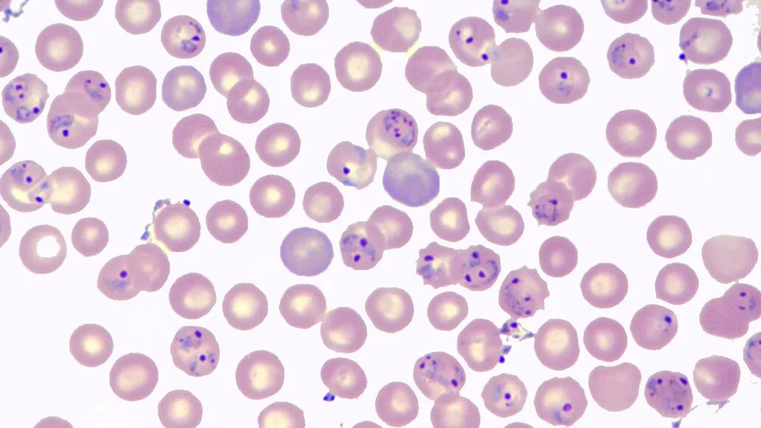
3D chromatin conformation analysis
upon depletion of PfAP2-P protein in Plasmodium falciparum
Aleksandra Kurowska
Rohit Satyam
Anel Lopez Gonzalez
Notes:
Var genes encode a family of virulence factors known as PfEMP1 (Plasmodium falciparum erythrocyte membrane protein 1) which are responsible for both antigenic variation and cytoadherence of infected erythrocytes.
In a recent study11, we identified 363 genes with a 24 h (circadian-like) rhythmic periodicity of expression in the 48-h P. falciparum IDC, one of which was an ApiAP2, now designated as PfAP2-P
PfAP2-P and its Plasmodium berghei orthologue (PBANKA_0939100) are essential for blood-stage development
PfAP2-P inducible exon 2 knockout of P. falciparum (PfAP2-P-3HA:loxP) in a parental line expressing rapamycin (RAPA)-inducible dimerizable Cre recombinase (DiCre)

Slide 2
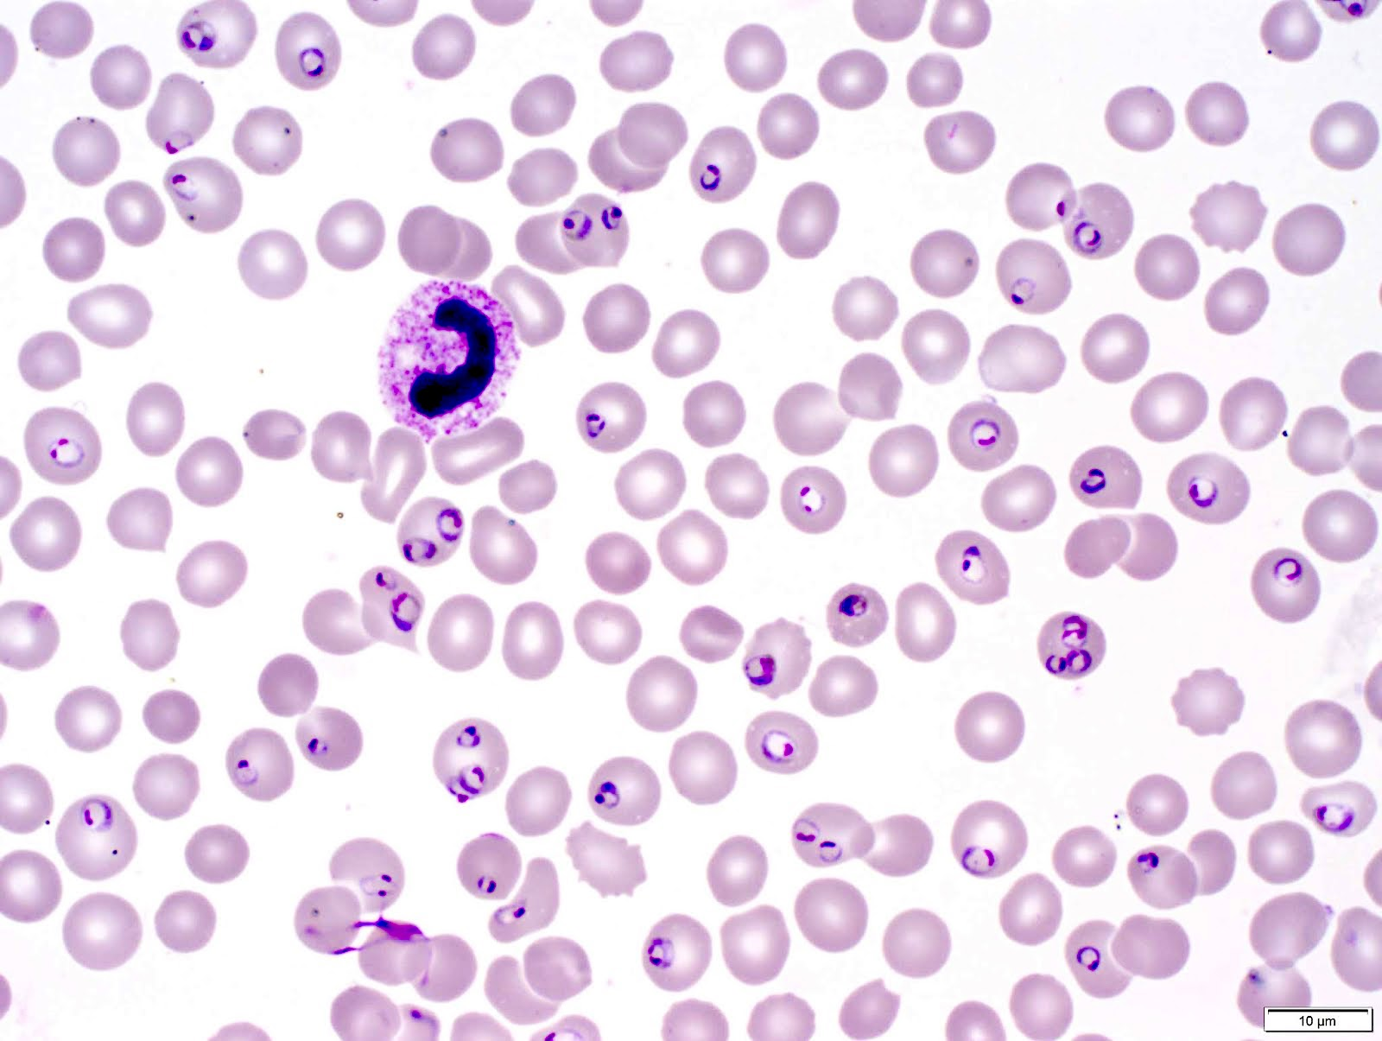
Outline
1. Introduction to 3D genome organization and Hi-C
2. Malaria: P. falciparum life cycle and genome
3. Research question
4. Pipeline
5. Results
6. Conclusion and limitations
Introduction
Biological question
Pipeline
Results
Discussion
Notes:
The apical complex allows this versatile lifestyle.

Slide 3
Outline
1. Introduction to 3D genome organization and Hi-C
2. Malaria: P. falciparum life cycle and genome
3. Research question
4. Pipeline
5. Results
6. Conclusion and limitations
Introduction
Biological question
Pipeline
Results
Discussion
Notes:
The apical complex allows this versatile lifestyle.

Slide 4
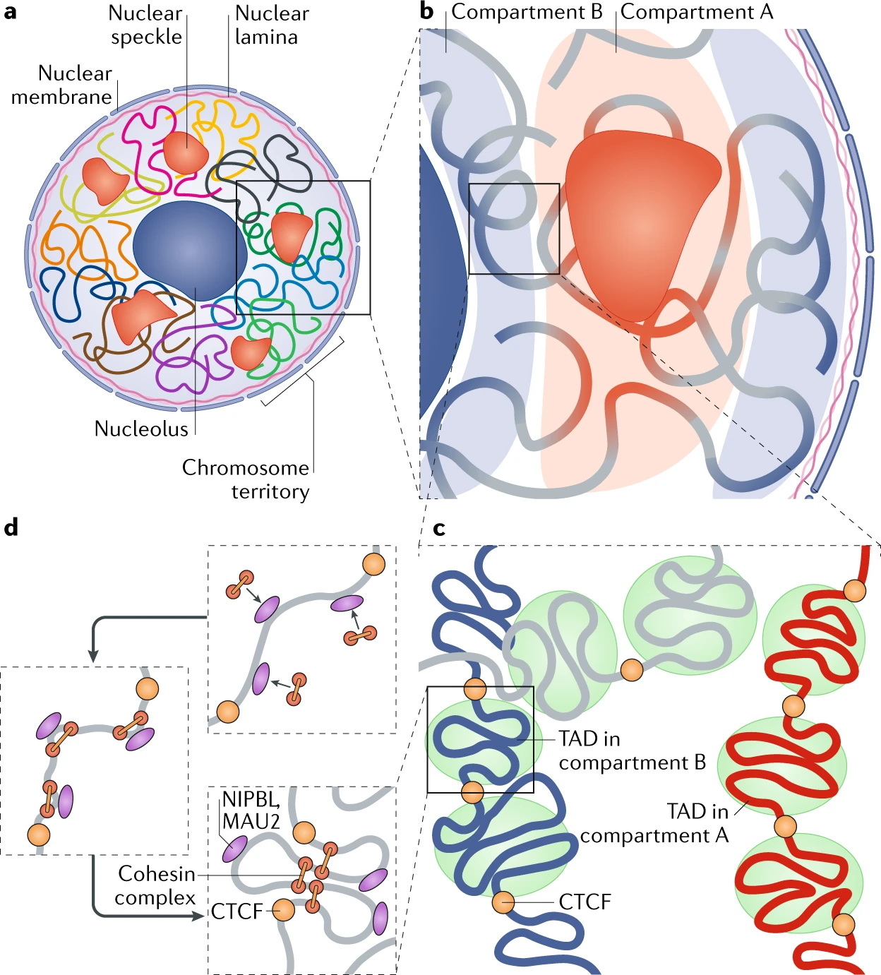
3D genome organization
Zheng, 2019
Introduction
Biological question
Pipeline
Results
Discussion
Notes:
Chromosomal territories: Discrete regions within the nucleus rarely interact with each other.
Compartments: Transcriptionally active and repressed regions that tend to localize nuclear speckles or the nuclear lamina .
TADs: Insulated subchromosomal domains that show strong self-interaction. Can belong to either compartment.
Chromatin loops: Contacts between distant genomic loci, often bringing together enhancers and promoters.

Slide 5
3D genome organization
Compartments
Zheng, 2019
Introduction
Biological question
Pipeline
Results
Discussion
Notes:
Chromosomal territories: Discrete regions within the nucleus rarely interact with each other.
Compartments: Transcriptionally active and repressed regions that tend to localize nuclear speckles or the nuclear lamina .
TADs: Insulated subchromosomal domains that show strong self-interaction. Can belong to either compartment.
Chromatin loops: Contacts between distant genomic loci, often bringing together enhancers and promoters.

Slide 6
3D genome organization
Topologically Associating Domains
Zheng, 2019
Introduction
Biological question
Pipeline
Results
Discussion
Notes:
Chromosomal territories: Discrete regions within the nucleus rarely interact with each other.
Compartments: Transcriptionally active and repressed regions that tend to localize nuclear speckles or the nuclear lamina .
TADs: Insulated subchromosomal domains that show strong self-interaction. Can belong to either compartment.
Chromatin loops: Contacts between distant genomic loci, often bringing together enhancers and promoters.

Slide 7
3D genome organization
Chromatin Loops
Zheng, 2019
Introduction
Biological question
Pipeline
Results
Discussion
Notes:
Chromosomal territories: Discrete regions within the nucleus rarely interact with each other.
Compartments: Transcriptionally active and repressed regions that tend to localize nuclear speckles or the nuclear lamina .
TADs: Insulated subchromosomal domains that show strong self-interaction. Can belong to either compartment.
Chromatin loops: Contacts between distant genomic loci, often bringing together enhancers and promoters.

Slide 8
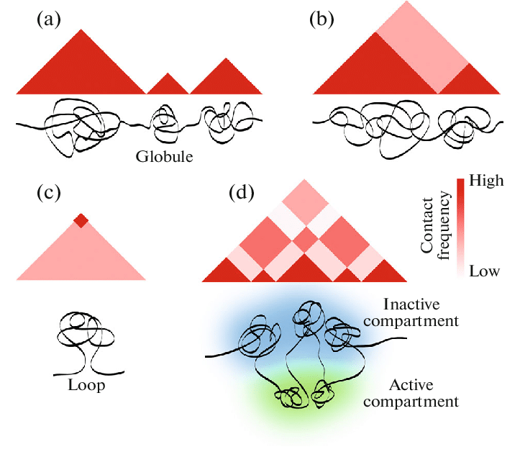
Hi-C maps
Visualization of chromatin interactions:
Each axis corresponds to a genomic region (on- and off-diagonal)
Color codes for frequency of interaction
Razin, 2019
Introduction
Biological question
Pipeline
Results
Discussion

Slide 9
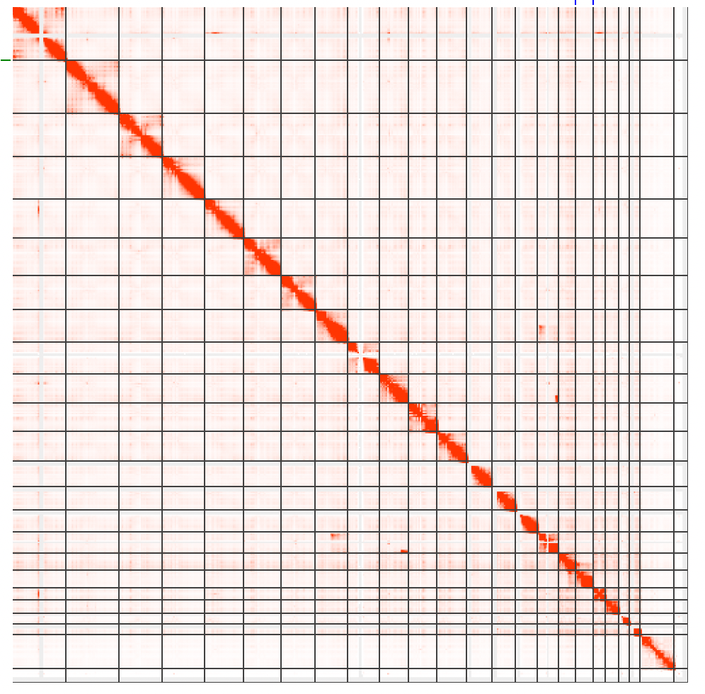
Detecting Chromatin Conformation with Hi-C
Rao, 2017
Introduction
Biological question
Pipeline
Results
Discussion
Notes:
Chromosomal territories: Discrete regions within the nucleus rarely interact with each other.
Compartments: Transcriptionally active and repressed regions that tend to localize nuclear speckles or the nuclear lamina .
TADs: Insulated subchromosomal domains that show strong self-interaction. Can belong to either compartment.
Chromatin loops: Contacts between distant genomic loci, often bringing together enhancers and promoters.

Slide 10
Detecting Chromatin Conformation with Hi-C
Intra-chromosomal interactions
Inter-chromosomal interactions
Rao, 2017
Introduction
Biological question
Pipeline
Results
Discussion
Notes:
Chromosomal territories: Discrete regions within the nucleus rarely interact with each other.
Compartments: Transcriptionally active and repressed regions that tend to localize nuclear speckles or the nuclear lamina .
TADs: Insulated subchromosomal domains that show strong self-interaction. Can belong to either compartment.
Chromatin loops: Contacts between distant genomic loci, often bringing together enhancers and promoters.

Slide 11
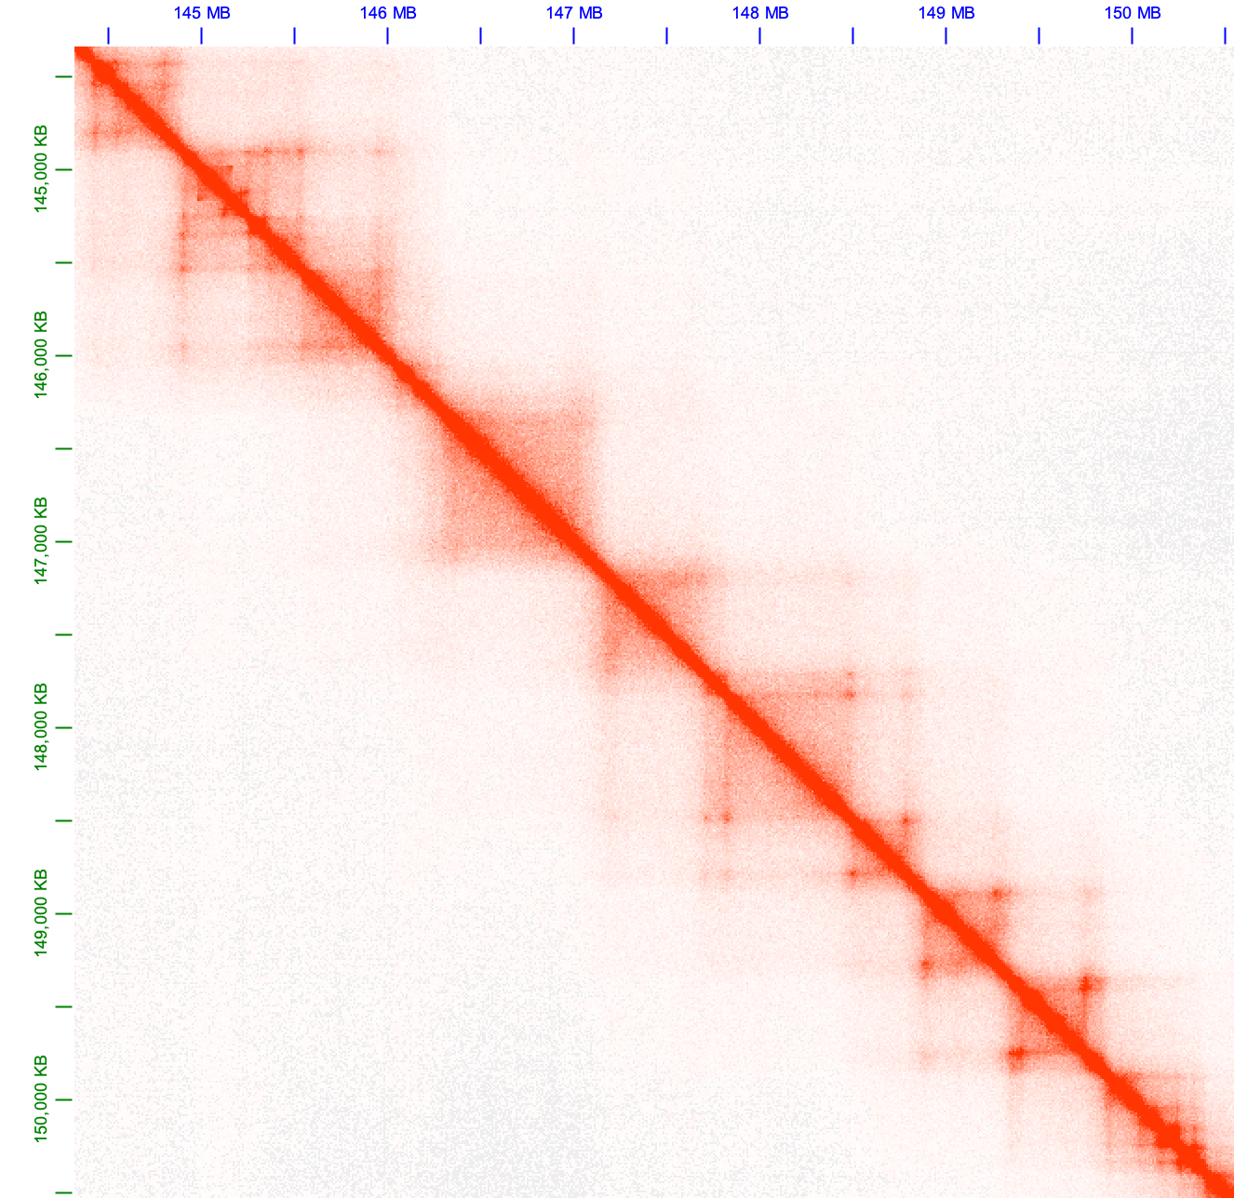
Detecting Chromatin Conformation with Hi-C
Rao, 2017
Introduction
Biological question
Pipeline
Results
Discussion
Notes:
Chromosomal territories: Discrete regions within the nucleus rarely interact with each other.
Compartments: Transcriptionally active and repressed regions that tend to localize nuclear speckles or the nuclear lamina .
TADs: Insulated subchromosomal domains that show strong self-interaction. Can belong to either compartment.
Chromatin loops: Contacts between distant genomic loci, often bringing together enhancers and promoters.

Slide 12
Detecting Chromatin Conformation with Hi-C
Rao, 2017
Introduction
Biological question
Pipeline
Results
Discussion
Notes:
Chromosomal territories: Discrete regions within the nucleus rarely interact with each other.
Compartments: Transcriptionally active and repressed regions that tend to localize nuclear speckles or the nuclear lamina .
TADs: Insulated subchromosomal domains that show strong self-interaction. Can belong to either compartment.
Chromatin loops: Contacts between distant genomic loci, often bringing together enhancers and promoters.

Slide 13
Detecting Chromatin Conformation with Hi-C
Interaction?
Rao, 2017
Introduction
Biological question
Pipeline
Results
Discussion
Notes:
Chromosomal territories: Discrete regions within the nucleus rarely interact with each other.
Compartments: Transcriptionally active and repressed regions that tend to localize nuclear speckles or the nuclear lamina .
TADs: Insulated subchromosomal domains that show strong self-interaction. Can belong to either compartment.
Chromatin loops: Contacts between distant genomic loci, often bringing together enhancers and promoters.

Slide 14
Detecting Chromatin Conformation with Hi-C
Interaction?
Rao, 2017
Introduction
Biological question
Pipeline
Results
Discussion
Notes:
Chromosomal territories: Discrete regions within the nucleus rarely interact with each other.
Compartments: Transcriptionally active and repressed regions that tend to localize nuclear speckles or the nuclear lamina .
TADs: Insulated subchromosomal domains that show strong self-interaction. Can belong to either compartment.
Chromatin loops: Contacts between distant genomic loci, often bringing together enhancers and promoters.

Slide 15
Detecting Chromatin Conformation with Hi-C
Interaction?
3D space interaction
Rao, 2017
Introduction
Biological question
Pipeline
Results
Discussion
Notes:
Chromosomal territories: Discrete regions within the nucleus rarely interact with each other.
Compartments: Transcriptionally active and repressed regions that tend to localize nuclear speckles or the nuclear lamina .
TADs: Insulated subchromosomal domains that show strong self-interaction. Can belong to either compartment.
Chromatin loops: Contacts between distant genomic loci, often bringing together enhancers and promoters.

Slide 16
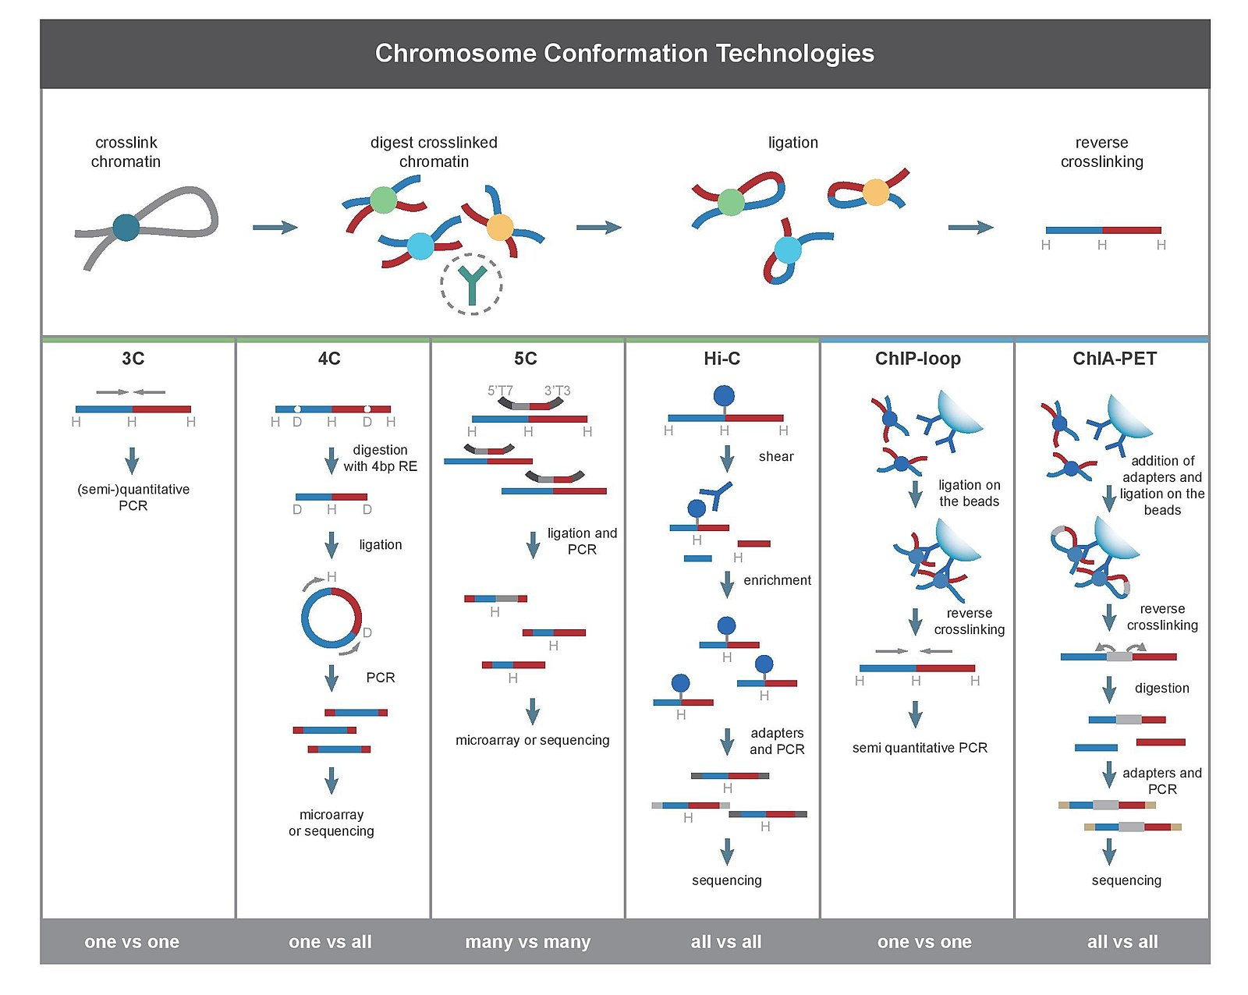
Technologies for chromosome conformation capture
Cross-link with formaldehyde
Restriction enzyme cutting
Proximity-based ligation
Library preparation
Wikipedia
Introduction
Biological question
Pipeline
Results
Discussion

Slide 17
Technologies for chromosome conformation capture
Cross-link with formaldehyde
Restriction enzyme cutting
Proximity-based ligation
Library preparation
Wikipedia
Introduction
Biological question
Pipeline
Results
Discussion

Slide 18
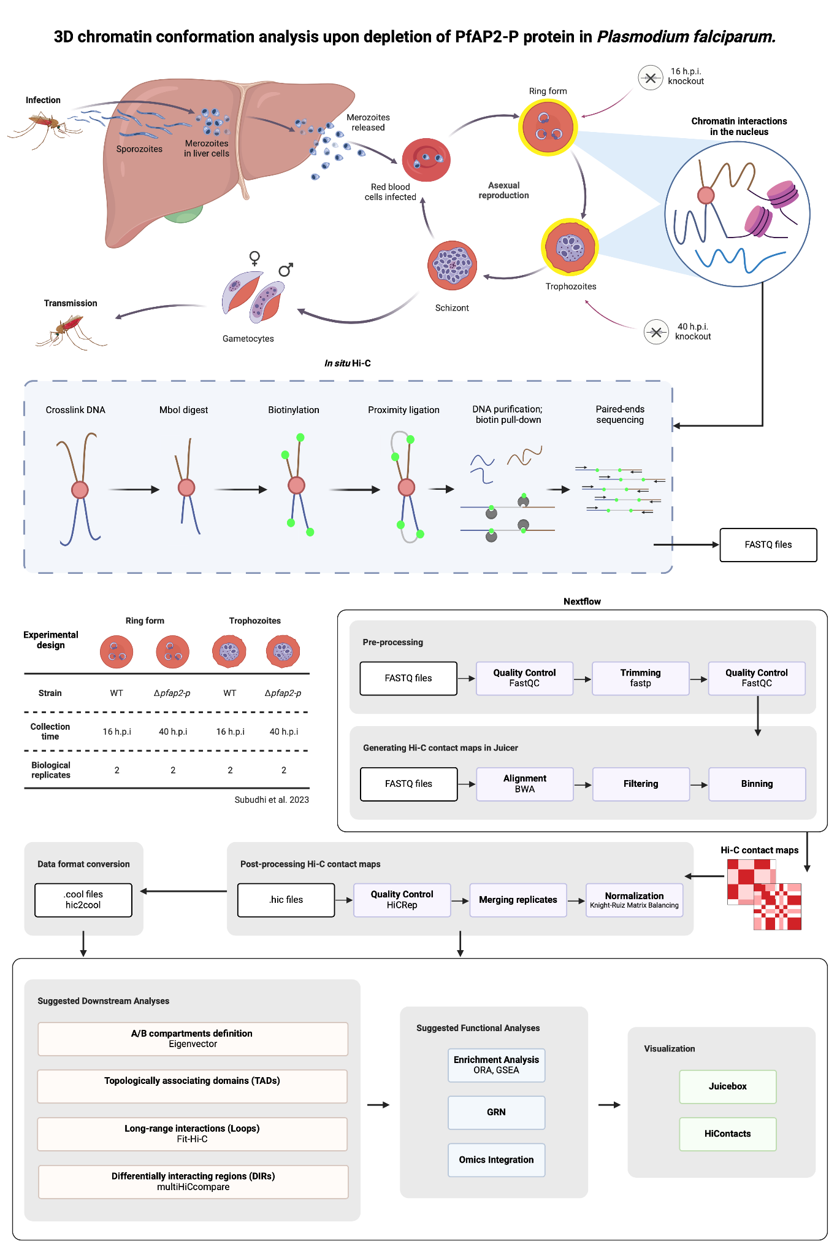
Hi-C Bioinformatics
Aligning
Pairing
FASTQ
files
Visualization
Filtering
Binning
Compartments
Normalization
Downstream Analysis
TADs
Loops
Introduction
Biological question
Pipeline
Results
Discussion

Slide 19
Outline
1. Introduction to 3D genome organization and Hi-C
2. Malaria: P. falciparum life cycle and genome
3. Research question
4. Pipeline
5. Results
6. Conclusion and limitations
Introduction
Biological question
Pipeline
Results
Discussion
Notes:
The apical complex allows this versatile lifestyle.

Slide 20
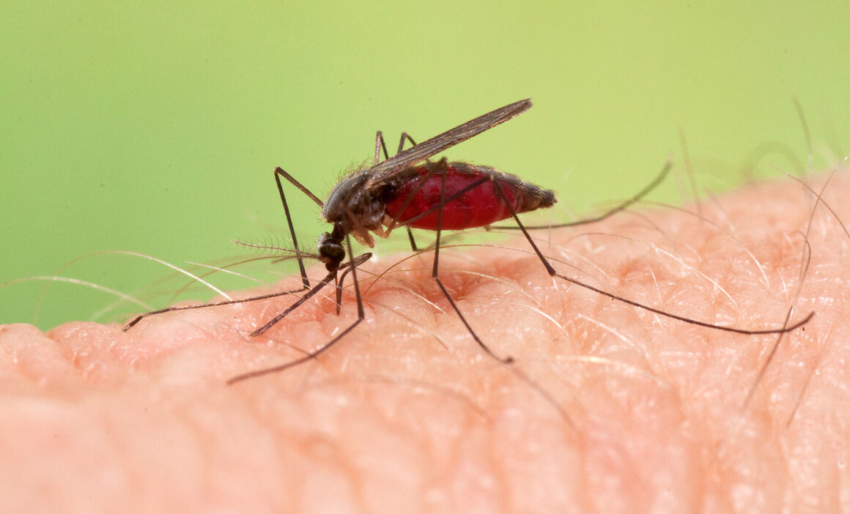
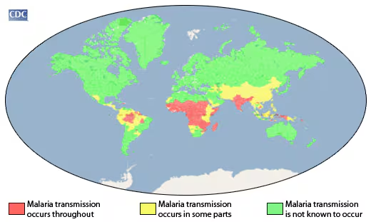
Malaria
ECDC, CDC
Malaria is a mosquito blood-borne disease caused by a parasite.
In 2022, 249 million cases of malaria were reported of which 608 000 ended up in fatality (WHO, 2023).
Malaria affects mainly developing countries with tropical climates, ~85 countries according to the WHO (2023).
Of the population affected, 80% are children under 5.
Introduction
Biological question
Pipeline
Results
Discussion

Slide 21
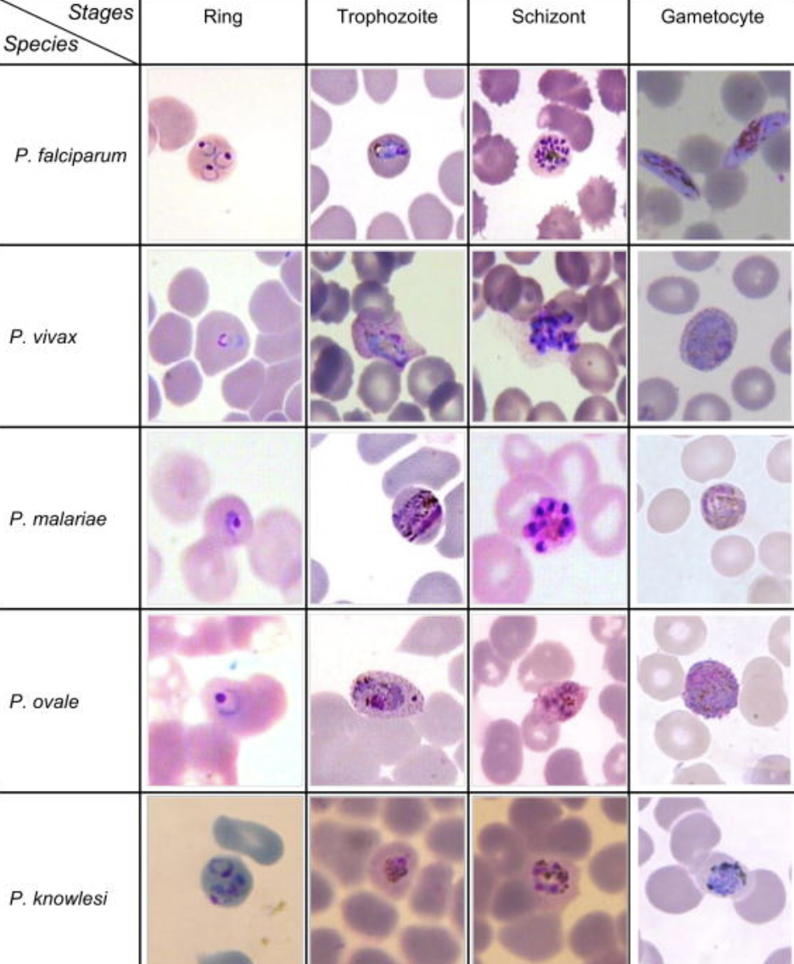
Plasmodium falciparum - overview
Plasmodium is a genus of eukaryotic obligated-parasites, including over 200 species.
They have a complex life cycle, first growing within a tissue and later invading the red blood cells.
P. falciparum is a unicellular pathogen, causing the deadliest form of malaria in humans.
P. falciparum is responsible for 50% of the total cases of malaria.
mmv.org
Introduction
Biological question
Pipeline
Results
Discussion
Notes:
There is more than 100 species of Plasmodium, 4 of these can infect humans. Recently, zoonotic events have allow for one more species to infect humans.

Slide 22
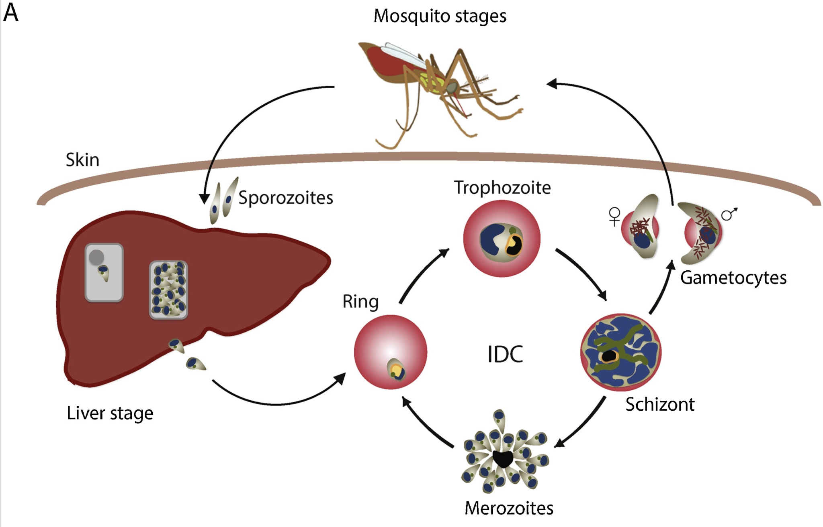
Plasmodium falciparum - life cycle
Sexual stage
Asexual stage
IDC - Intraerythrocytic developmental cycle
Le Roch, 2019
Introduction
Biological question
Pipeline
Results
Discussion
Notes:
Sporozoites are injected into blood stream.
Upon entering the liver the parasytes transitions into trophozoites, then a schizont.
From a schizont thousands of haploid merozoites are released into the bloodstream.
Intraerythrocytic developmental cycle (IDC), consists of asexual reproduction
Environmental stress can cause sexual development or production of gametocytes.
The cycle is completed when gametocytes are ingested by a female mosquito.

Slide 23
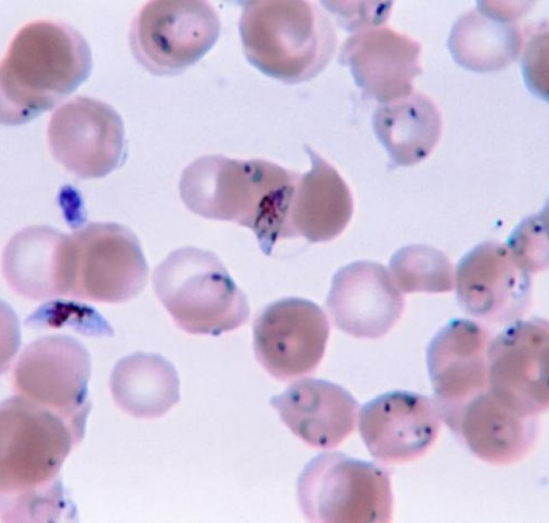
Plasmodium falciparum - genome
Extremely rich in AT
23 megabases long
Low number of identified TFs
14 chromosomes
Different use of histone marks
Different distribution of nucleosomes
Haploid during the IDC
~5700 genes
Introduction
Biological question
Pipeline
Results
Discussion
Notes:
This is a challenge when it come to identify regulatory elements in the genome.
AT rich, specially in introns and intergenic regions.
Imagen del bicho, y sacar flechitas que digan las características

Slide 24
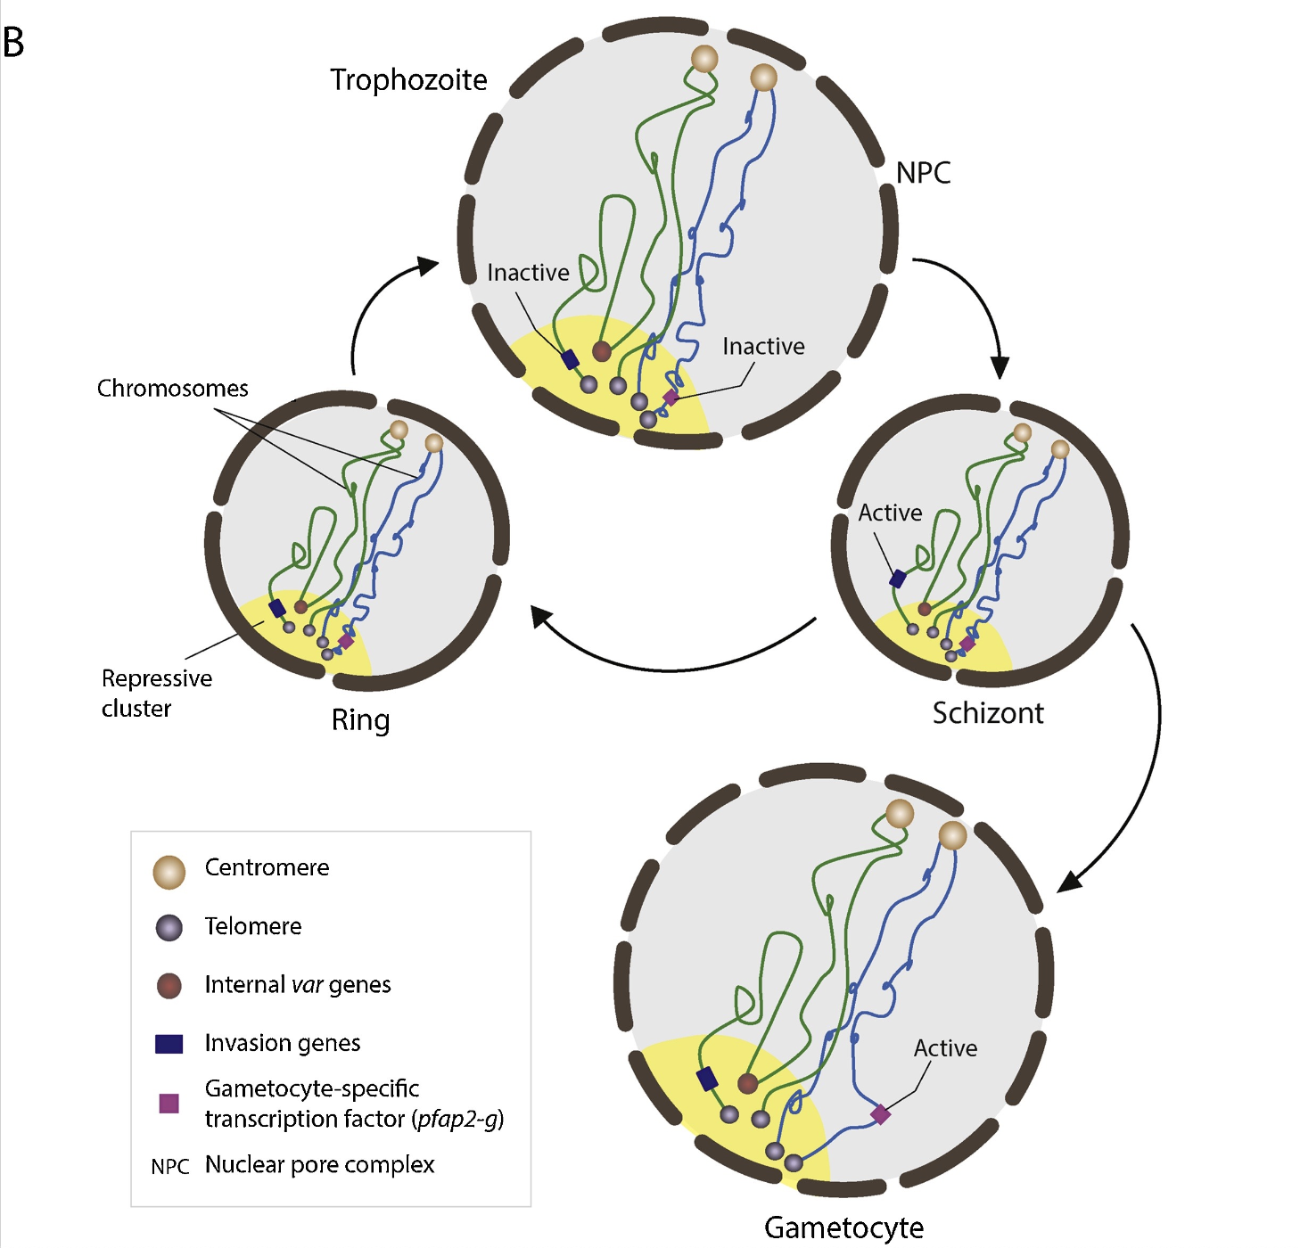
Plasmodium falciparum - genome organization
Chromosomes are arranged with the telomeres and centromeres at opposite poles.
During the transition from ring to trophozoite, the nucleus is subject to size and pore increase. Nucleosomes are evicted.
At schizont stage, nucleosomes are reassembled.
Different 3D organization allows for switch of the transcriptional program.
At the schizont stage, invasion genes are active.
pfap2-g is activated during gametocyte stage.
Le Roch, 2019
Introduction
Biological question
Pipeline
Results
Discussion
Notes:
This is a challenge when it come to identify regulatory elements in the genome.
AT rich, specially in introns and intergenic regions.
REMARK THE 3D ORGANIZATION OF MALARIA: no clear TADs/compartments

Slide 25
Plasmodium falciparum - genome organization
Chromosomes are arranged with the telomeres and centromeres at opposite poles.
During the transition from ring to trophozoite, the nucleus is subject to size and pore increase. Nucleosomes are evicted.
At schizont stage, nucleosomes are reassembled.
Different 3D organization allows for switch of the transcriptional program.
No clear TADs/compartments.
Le Roch, 2019
Introduction
Biological question
Pipeline
Results
Discussion

Slide 26
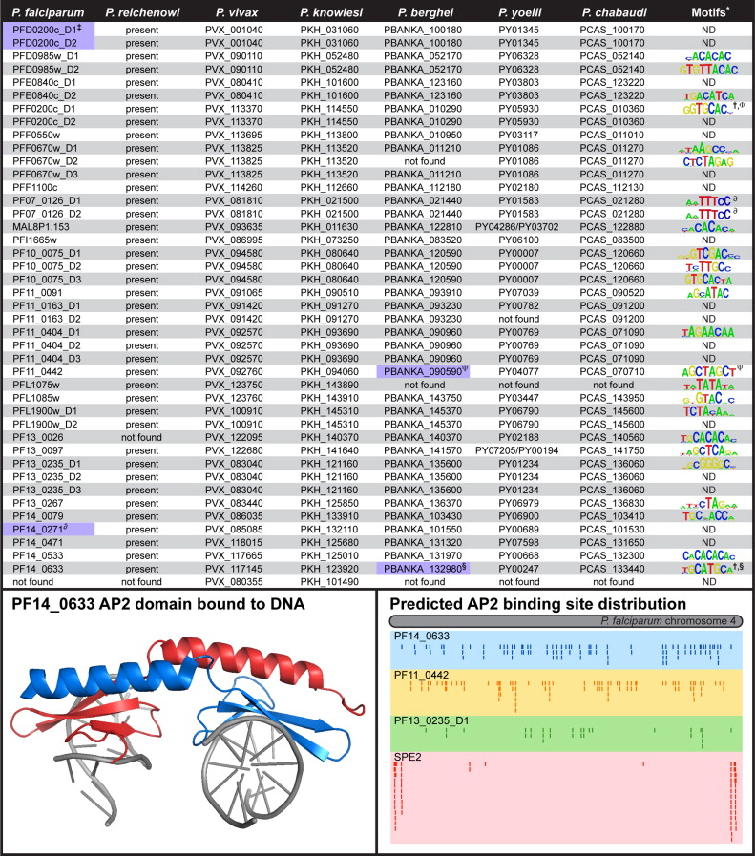
Apicomplexan AP2 transcription factor
ApiAP2 family of transcription factors has 27 members, conserverved across the Plasmodium species.
ApiAP2 TFs are highly expressed across the IDC.
PfAP2-P protein has two peak expression points at 16 and 40 hours post invasion, coinciding with high expression of var genes and invasion and egress genes, respectively.
Painter, 2011
Introduction
Biological question
Pipeline
Results
Discussion
Notes:
The timing of ApiAP2 gene expression can be clustered into four major classes corresponding to the ring, early trophozoite, early schizont, and schizont stages of intraerythrocytic developmen

Slide 27
Outline
1. Introduction to 3D genome organization and Hi-C
2. Malaria: P. falciparum life cycle and genome
3. Research question
4. Pipeline
5. Results
6. Conclusion and limitations
Introduction
Biological question
Pipeline
Results
Discussion
Notes:
The apical complex allows this versatile lifestyle.

Slide 28
Question and objectives
Previous studies have shown that knockout of PfAP2-P leads to expression of genes previously situated within heterochromatin regions.
This suggests that heterochromatin may have become more accessible.
Introduction
Biological question
Pipeline
Results
Discussion
Notes:
Within the apicomplexa family, we can the genus Plasmodium. Malaria causing parasites belong to this genus.

Slide 29
Question and objectives
Previous studies have shown that knockout of PfAP2-P leads to expression of genes previously situated within heterochromatin regions.
This suggests that heterochromatin may have become more accessible.
Can PfAP2-P modify the chromatin structure in P. falciparum?
Use Hi-C to investigate the role of AP2-P in chromatin remodeling.
Introduction
Biological question
Pipeline
Results
Discussion
Notes:
Within the apicomplexa family, we can the genus Plasmodium. Malaria causing parasites belong to this genus.

Slide 30

Experimental design
RAPA-inducible knockout of PfAP2-P to disturb the peak expression points at 16 and 40 hrs, corresponding to trophozoite and ring stages respectively.
In situ Hi-C, Illumina sequencing 100bp paired-end.
Subudhi, 2023
Introduction
Biological question
Pipeline
Results
Discussion
Notes:
Subudhi

Slide 31
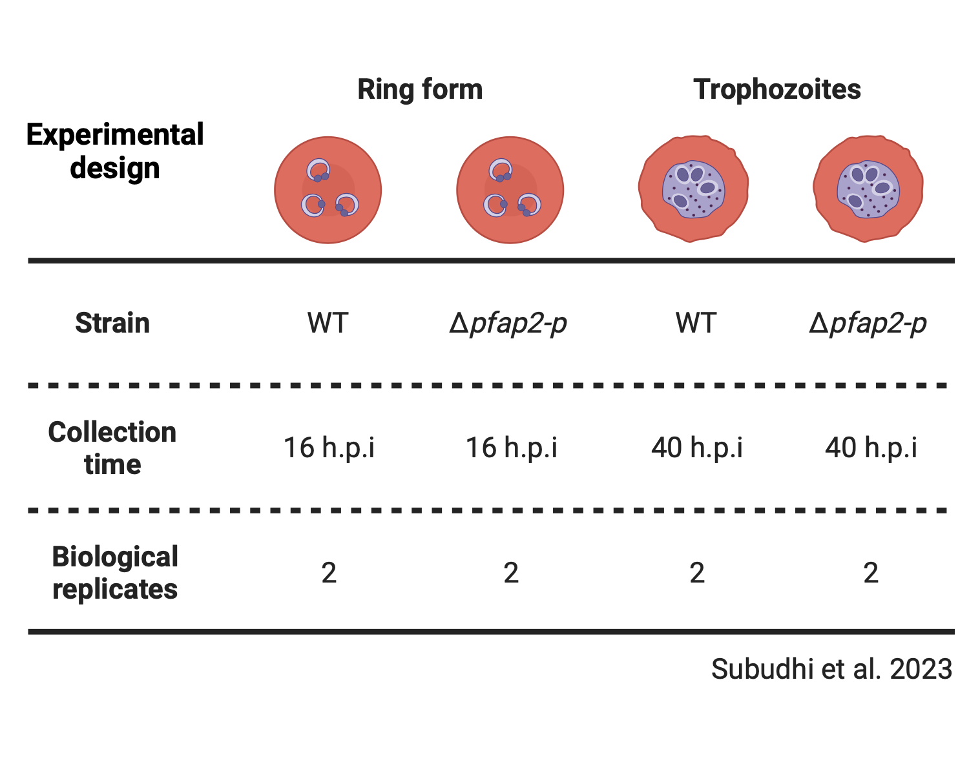
Experimental design
RAPA-inducible knockout of PfAP2-P to disturb the peak expression points at 16 and 40 hrs, corresponding to trophozoite and ring stages respectively.
In situ Hi-C, Illumina sequencing 100bp paired-end.
Subudhi, 2023
Introduction
Biological question
Pipeline
Results
Discussion
Notes:
Subudhi

Slide 32
Outline
1. Introduction to 3D genome organization and Hi-C
2. Malaria: P. falciparum life cycle and genome
3. Research question
4. Pipeline
5. Results
6. Conclusion and limitations
Introduction
Biological question
Pipeline
Results
Discussion
Notes:
The apical complex allows this versatile lifestyle.

Slide 33
Pipeline - Overview
Introduction
Biological question
Pipeline
Results
Discussion
Notes:
Within the apicomplexa family, we can the genus Plasmodium. Malaria causing parasites belong to this genus.

Slide 34
Pipeline - Overview
Introduction
Biological question
Pipeline
Results
Discussion
Notes:
Within the apicomplexa family, we can the genus Plasmodium. Malaria causing parasites belong to this genus.

Slide 35

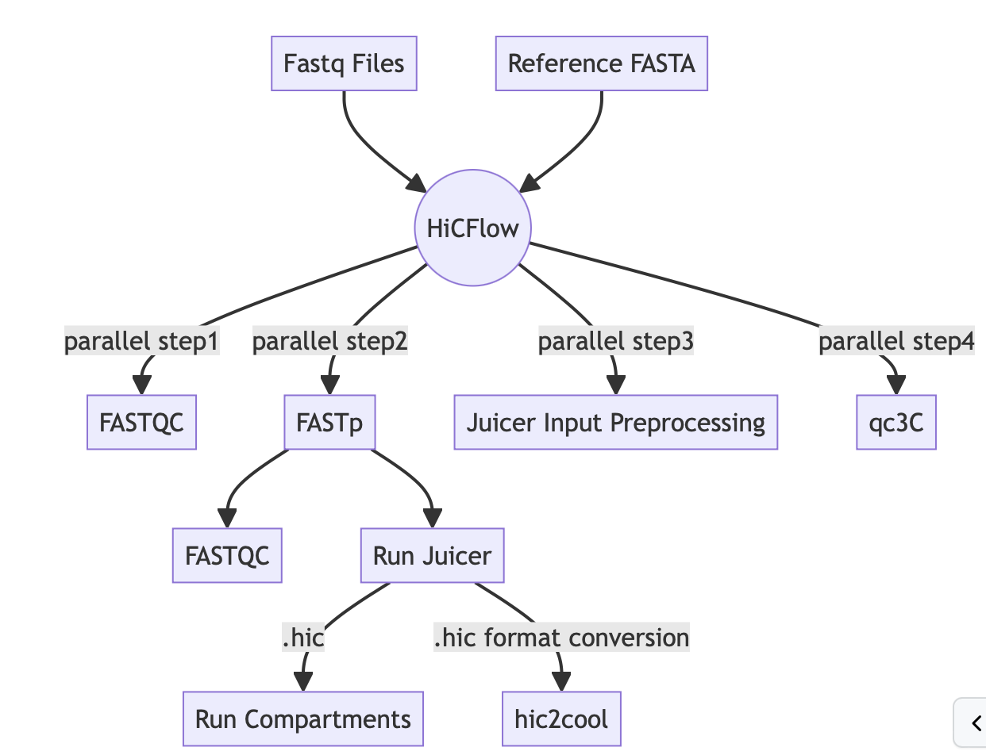
Pipeline - Overview
Introduction
Biological question
Pipeline
Results
Discussion
Notes:
Within the apicomplexa family, we can the genus Plasmodium. Malaria causing parasites belong to this genus.

Slide 36
Pipeline - Overview
Introduction
Biological question
Pipeline
Results
Discussion
Notes:
Within the apicomplexa family, we can the genus Plasmodium. Malaria causing parasites belong to this genus.

Slide 37
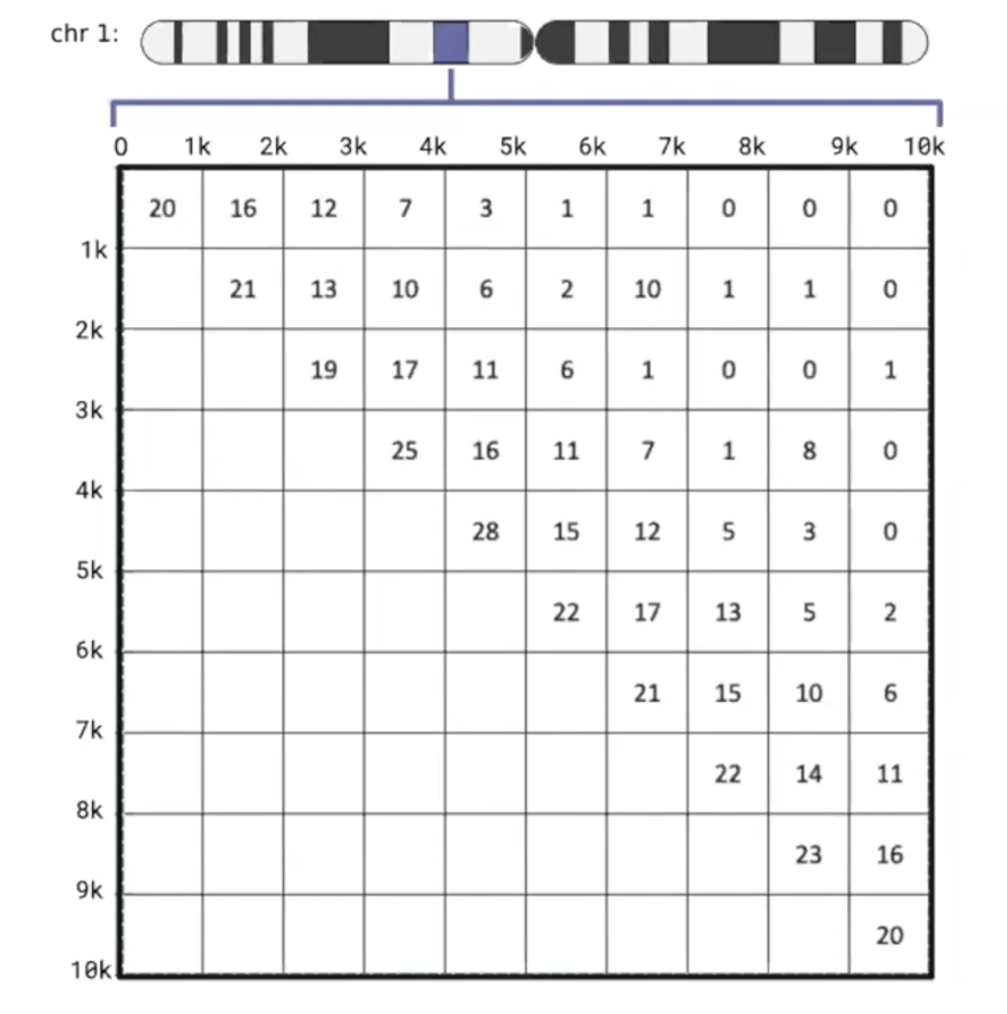
Pipeline - Overview
1kb bin size == 1kb resolution
Introduction
Biological question
Pipeline
Results
Discussion
Notes:
Within the apicomplexa family, we can the genus Plasmodium. Malaria causing parasites belong to this genus.

Slide 38
Pipeline - Overview
1kb bin size == 1kb resolution
10 reads between
these two regions
1kb - 2kb
…
6kb - 7kb
Introduction
Biological question
Pipeline
Results
Discussion
Notes:
Within the apicomplexa family, we can the genus Plasmodium. Malaria causing parasites belong to this genus.

Slide 39
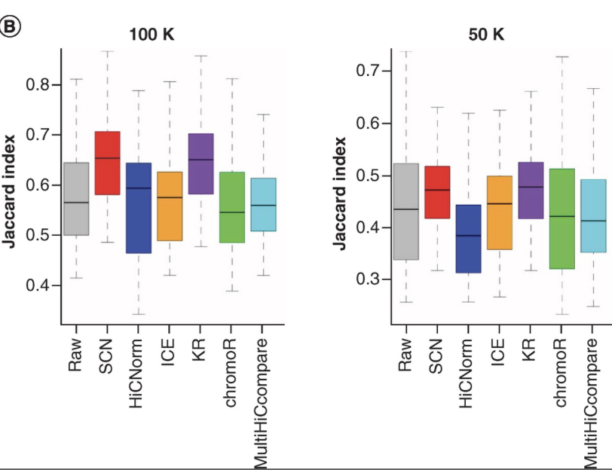
Pipeline - Overview
Lyu, 2020
Introduction
Biological question
Pipeline
Results
Discussion
Notes:
Within the apicomplexa family, we can the genus Plasmodium. Malaria causing parasites belong to this genus.

Slide 40
Pipeline - Overview
Reads can be unevenly distributed across the genome due to:
Cutting at enzyme sites
Genome mappability
GC contents
This introduce biases when calculating pairwise contacts.
Knight-Ruiz Matrix Balancing (KR): It balances the data so that all rows and columns have similar sums. Such matrix are called balanced matrix. This normalization is iterative.
Introduction
Biological question
Pipeline
Results
Discussion
Notes:
Within the apicomplexa family, we can the genus Plasmodium. Malaria causing parasites belong to this genus.

Slide 41
Pipeline - Overview
Introduction
Biological question
Pipeline
Results
Discussion
Notes:
Within the apicomplexa family, we can the genus Plasmodium. Malaria causing parasites belong to this genus.

Slide 42
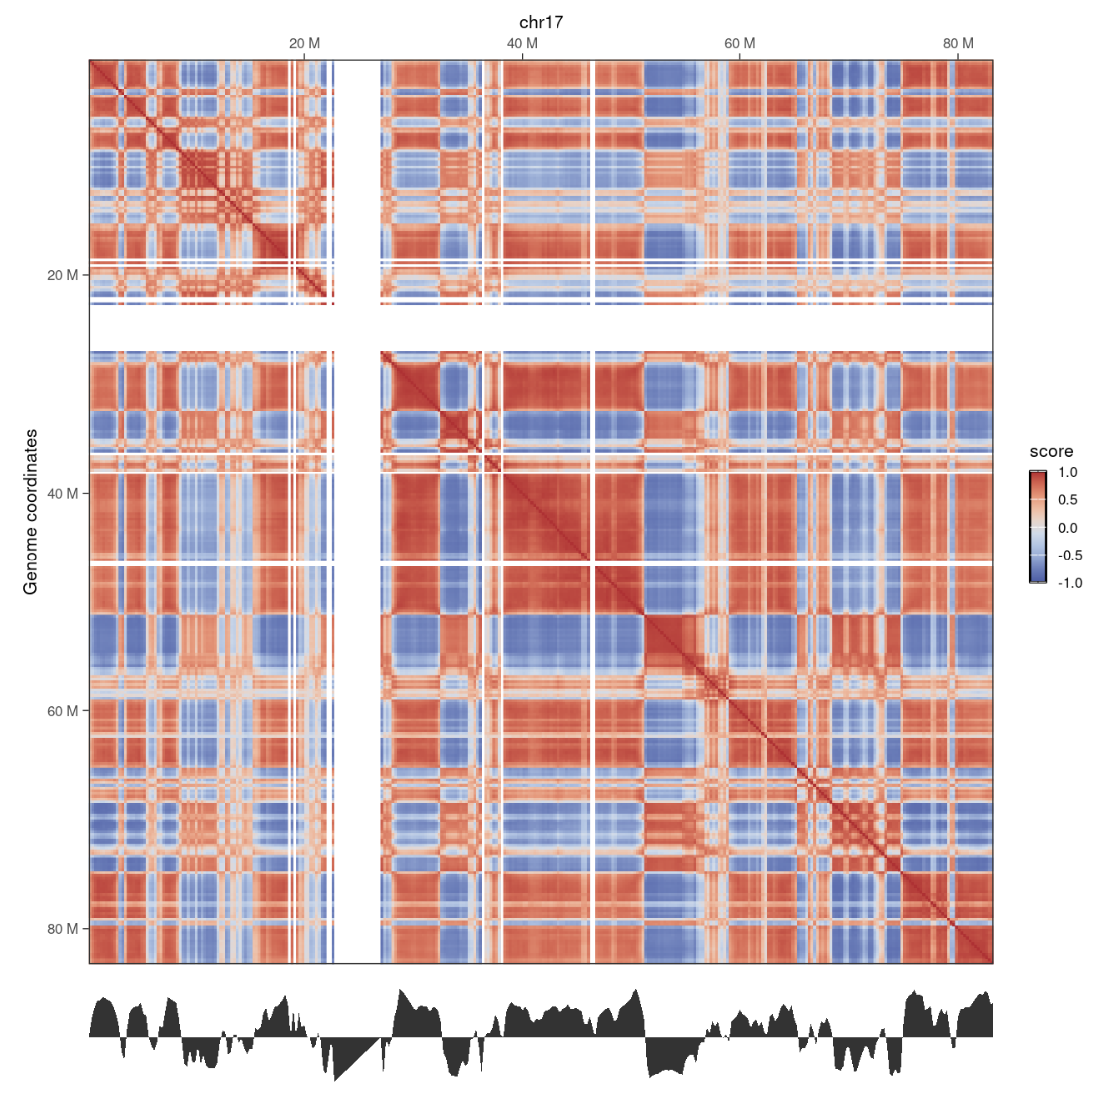
Pipeline - Overview
Hi-C correlation matrix
The eigenvector representing chromosome segmentation into 2 compartments: A (for positive values) and B (for negative values).
Introduction
Biological question
Pipeline
Results
Discussion
Notes:
Within the apicomplexa family, we can the genus Plasmodium. Malaria causing parasites belong to this genus.

Slide 43
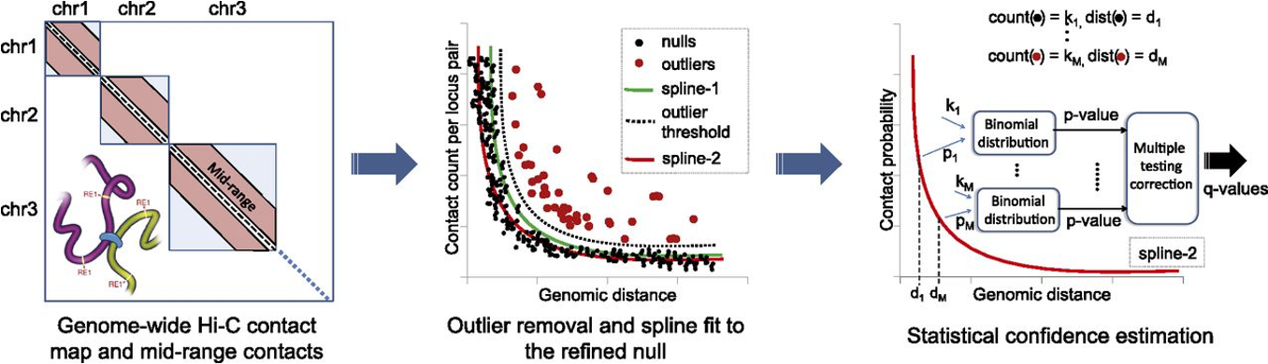
Pipeline - Overview
Ferhat Ay, 2014
Introduction
Biological question
Pipeline
Results
Discussion
Notes:
We fit an initial spline (spline-1) using the observed contact counts and genomic distances between all possible mid-range locus pairs. The general shape of the spline is assumed to be due to random polymer looping and is the basis for the initial null model. This initial spline determines a threshold (dashed line) to identify outliers (red dots) which are excluded from the calculation of a refined null represented by a second spline (spline-2). For each mid-range locus pair, we estimate the prior contact probability from spline-2 using the exact genomic distance between the loci in the pair. We calculate P-values for all contacts, including null and outlier pairs, by using a binomial distribution and apply multiple hypothesis testing correction to compute a Q-value for each P-value.

Slide 44
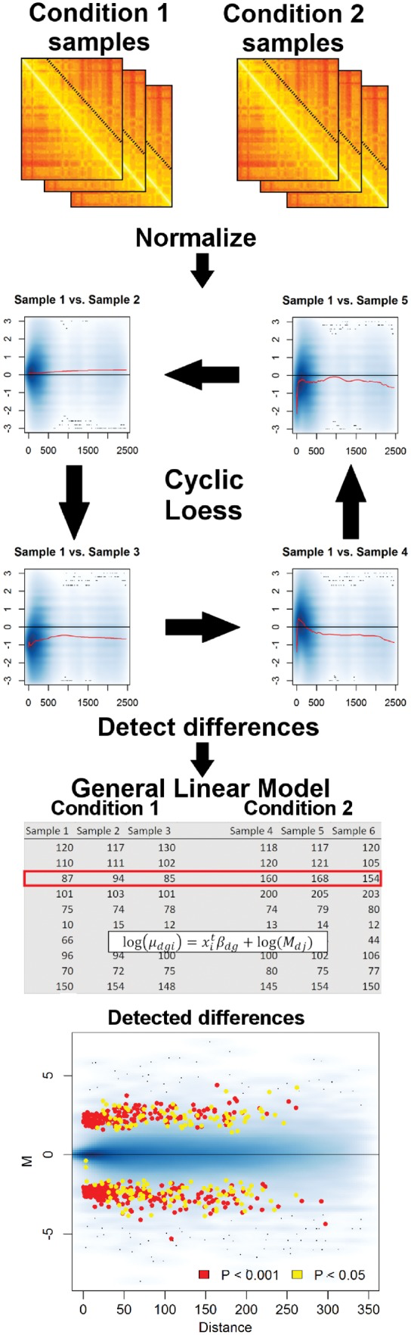
Pipeline - Overview
Introduction
Biological question
Pipeline
Results
Discussion
Notes:
Within the apicomplexa family, we can the genus Plasmodium. Malaria causing parasites belong to this genus.

Slide 45
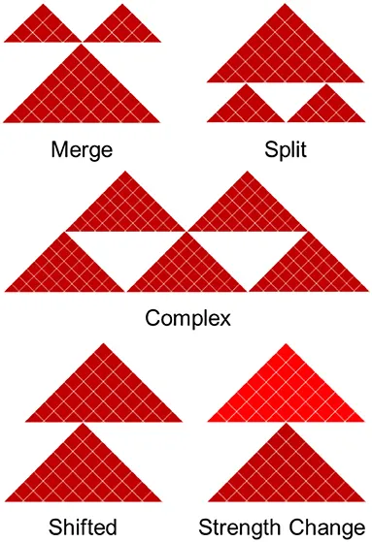
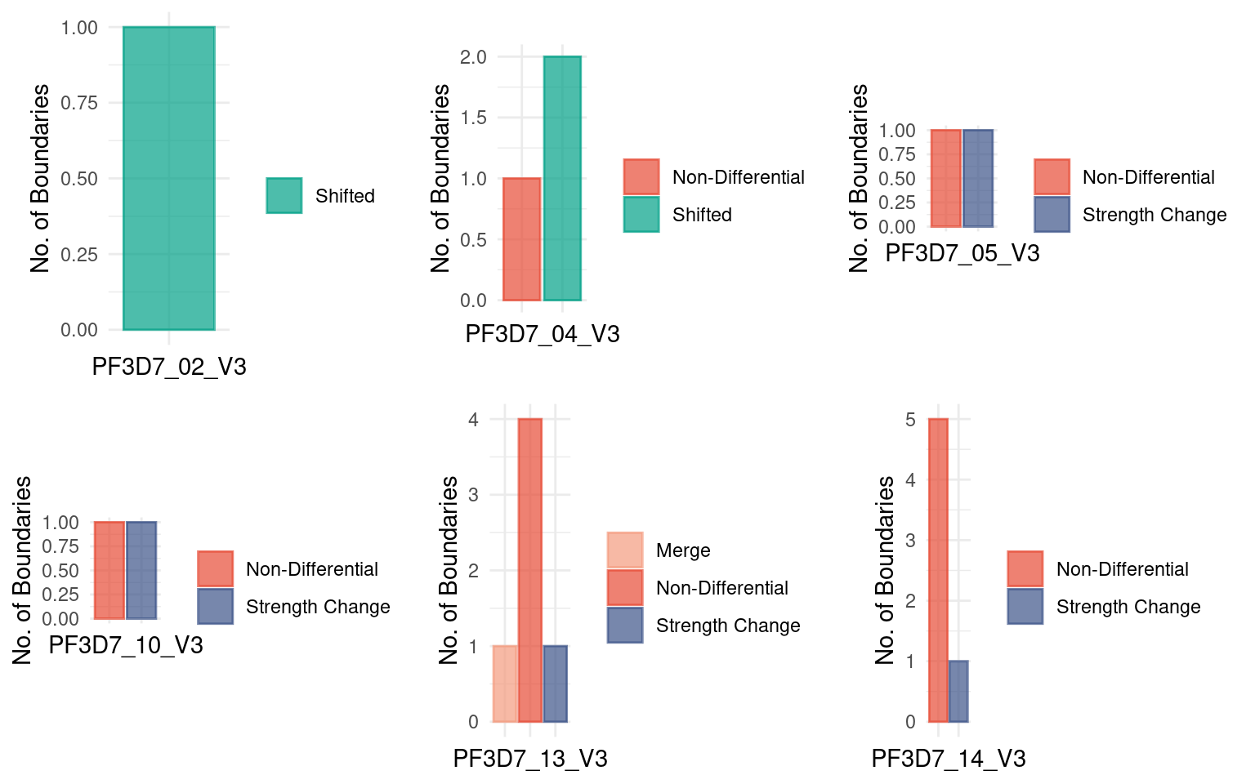
Pipeline - Overview
Introduction
Biological question
Pipeline
Results
Discussion
Notes:
Within the apicomplexa family, we can the genus Plasmodium. Malaria causing parasites belong to this genus.

Slide 46
Outline
1. Introduction to 3D genome organization and Hi-C
2. Malaria: P. falciparum life cycle and genome
3. Research question
4. Pipeline
5. Results
6. Conclusion and limitations
Introduction
Biological question
Pipeline
Results
Discussion
Notes:
The apical complex allows this versatile lifestyle.

Slide 47
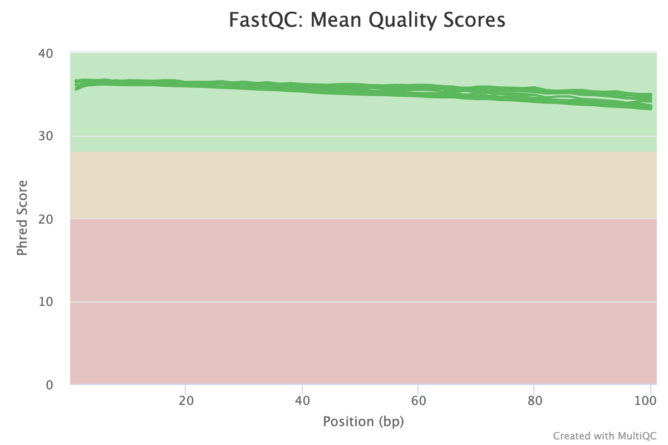
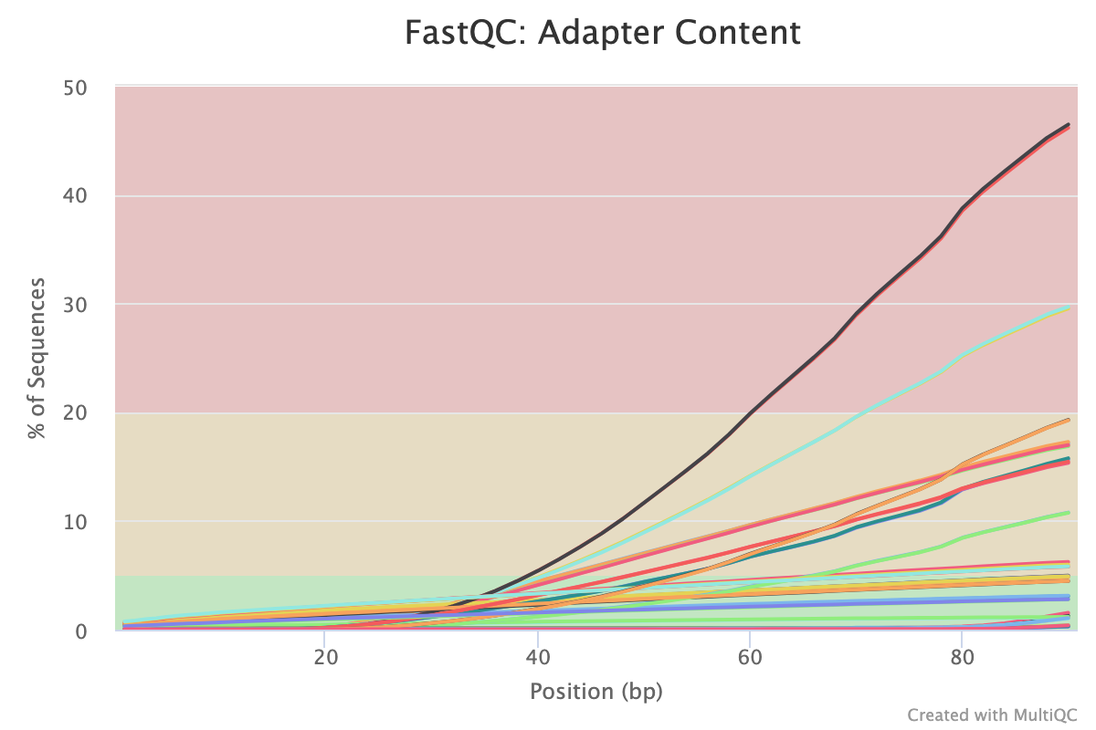
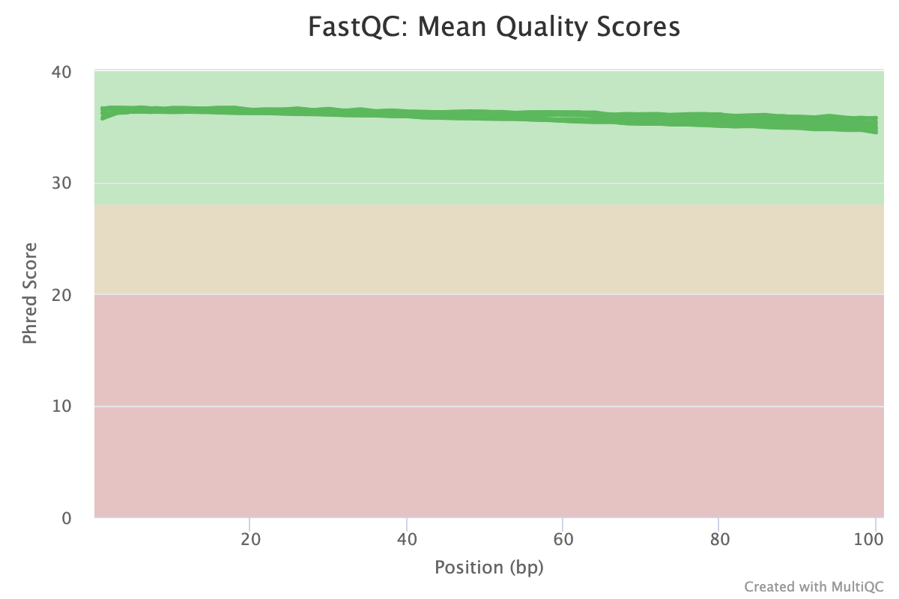
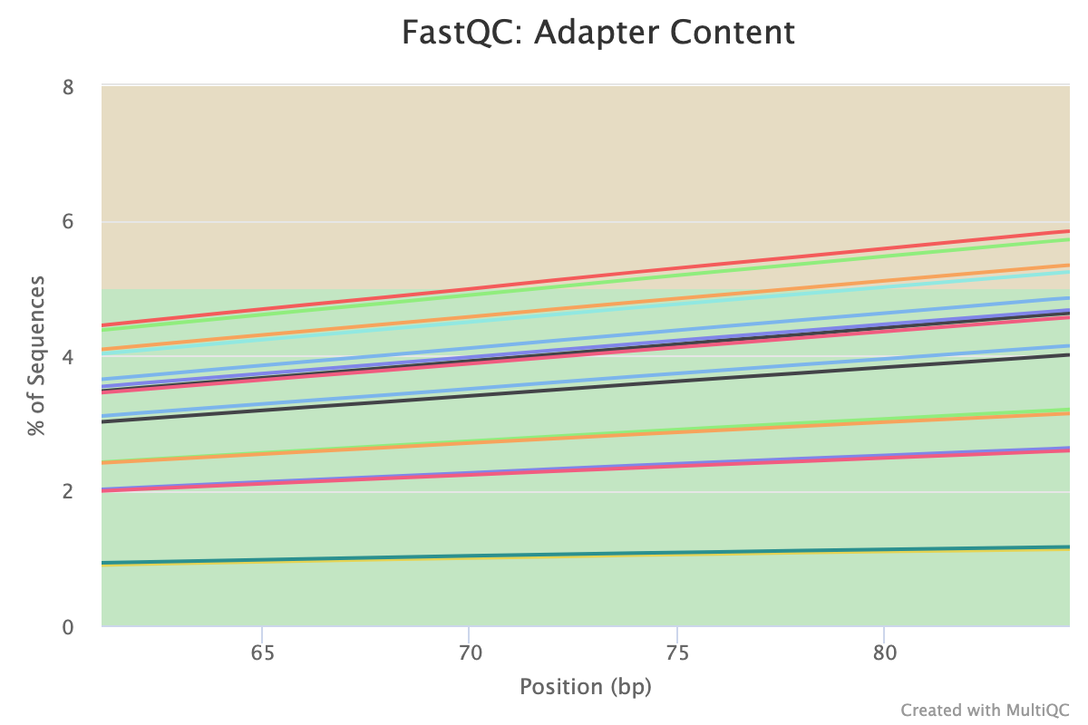
Quality control of raw reads and trimmed reads
raw
post-trimming
Introduction
Biological question
Pipeline
Results
Discussion
Notes:
Within the apicomplexa family, we can the genus Plasmodium. Malaria causing parasites belong to this genus.

Slide 48
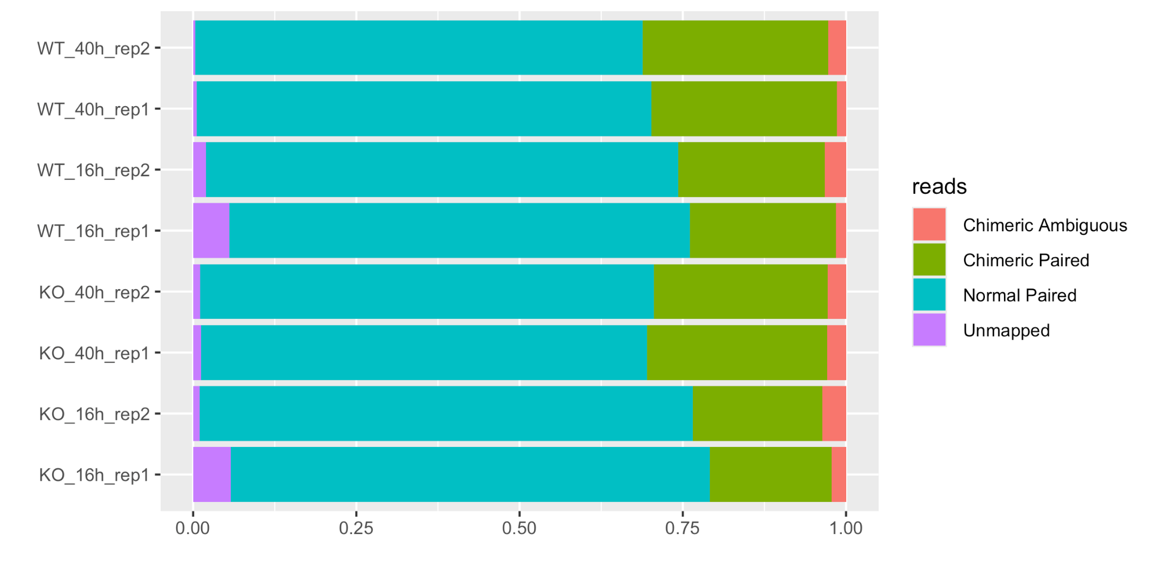
Alignment
> 90 % of valid reads out of total sequenced
Introduction
Biological question
Pipeline
Results
Discussion
Notes:
Within the apicomplexa family, we can the genus Plasmodium. Malaria causing parasites belong to this genus.

Slide 49
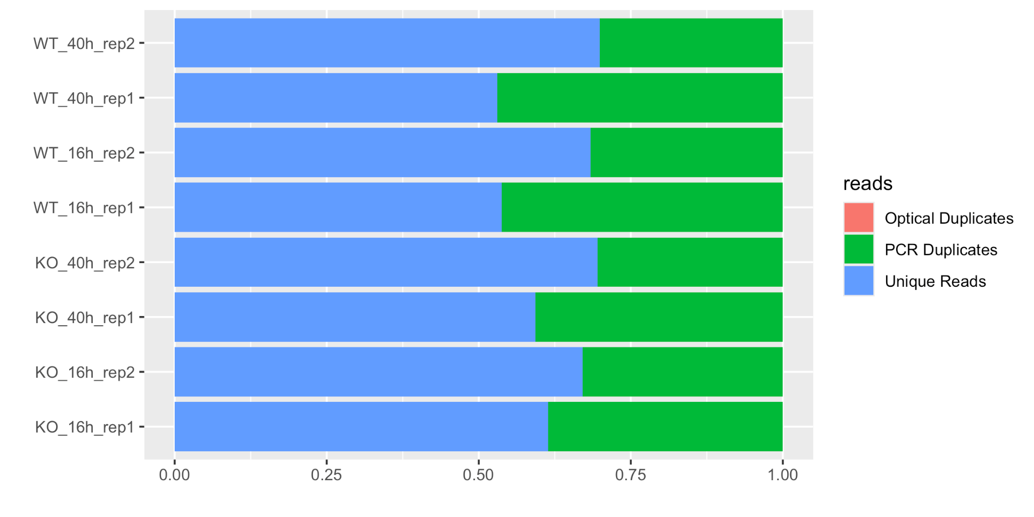
Filtering
~ 60 % of unique reads out of valid reads
Introduction
Biological question
Pipeline
Results
Discussion
Notes:
Within the apicomplexa family, we can the genus Plasmodium. Malaria causing parasites belong to this genus.

Slide 50
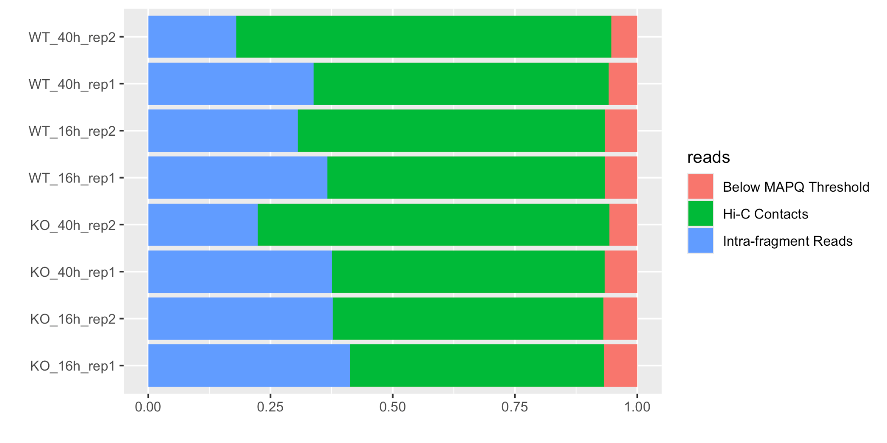
Filtering
< 10 % of reads with low quality
~ 60 % of Hi-C contacts
Introduction
Biological question
Pipeline
Results
Discussion
Notes:
Within the apicomplexa family, we can the genus Plasmodium. Malaria causing parasites belong to this genus.

Slide 51
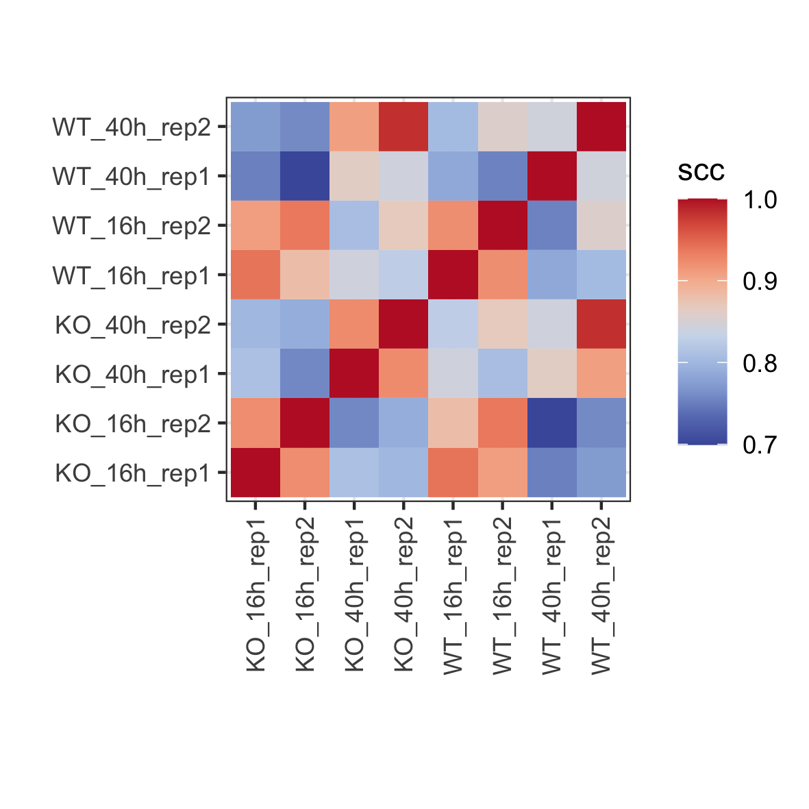
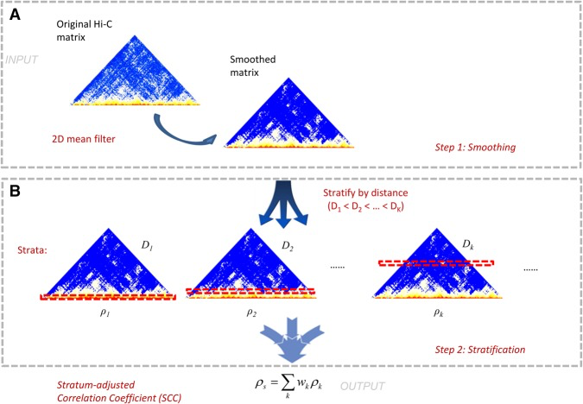
Biological replicates
Introduction
Biological question
Pipeline
Results
Discussion
Notes:
The first stage is smoothing the raw contact matrix in order to reduce local noise in the contact map and to make domain structures more visible. The smoothing is accomplished by applying a 2D mean filter, which replaces the read count of each contact in the contact map with the average counts of all contacts in its neighborhood. In the second stage, we applied a stratification approach to account for the pronounced distance dependence in the Hi-C data. This stage proceeded in two steps. First, we stratified the smoothed chromatin interactions according to their genomic distance, and then we applied a novel stratum-adjusted correlation coefficient statistic (SCC) to assess the reproducibility of the Hi-C matrices. The SCC statistic was calculated by computing a Pearson correlation coefficient for each stratum (Fig. 2) and then aggregating the stratum-specific correlation coefficients using a weighted average, with the weights derived from the generalized Cochran–Mantel–Haenszel (CMH) statistic (Mantel 1963; Agresti 2012).

Slide 52
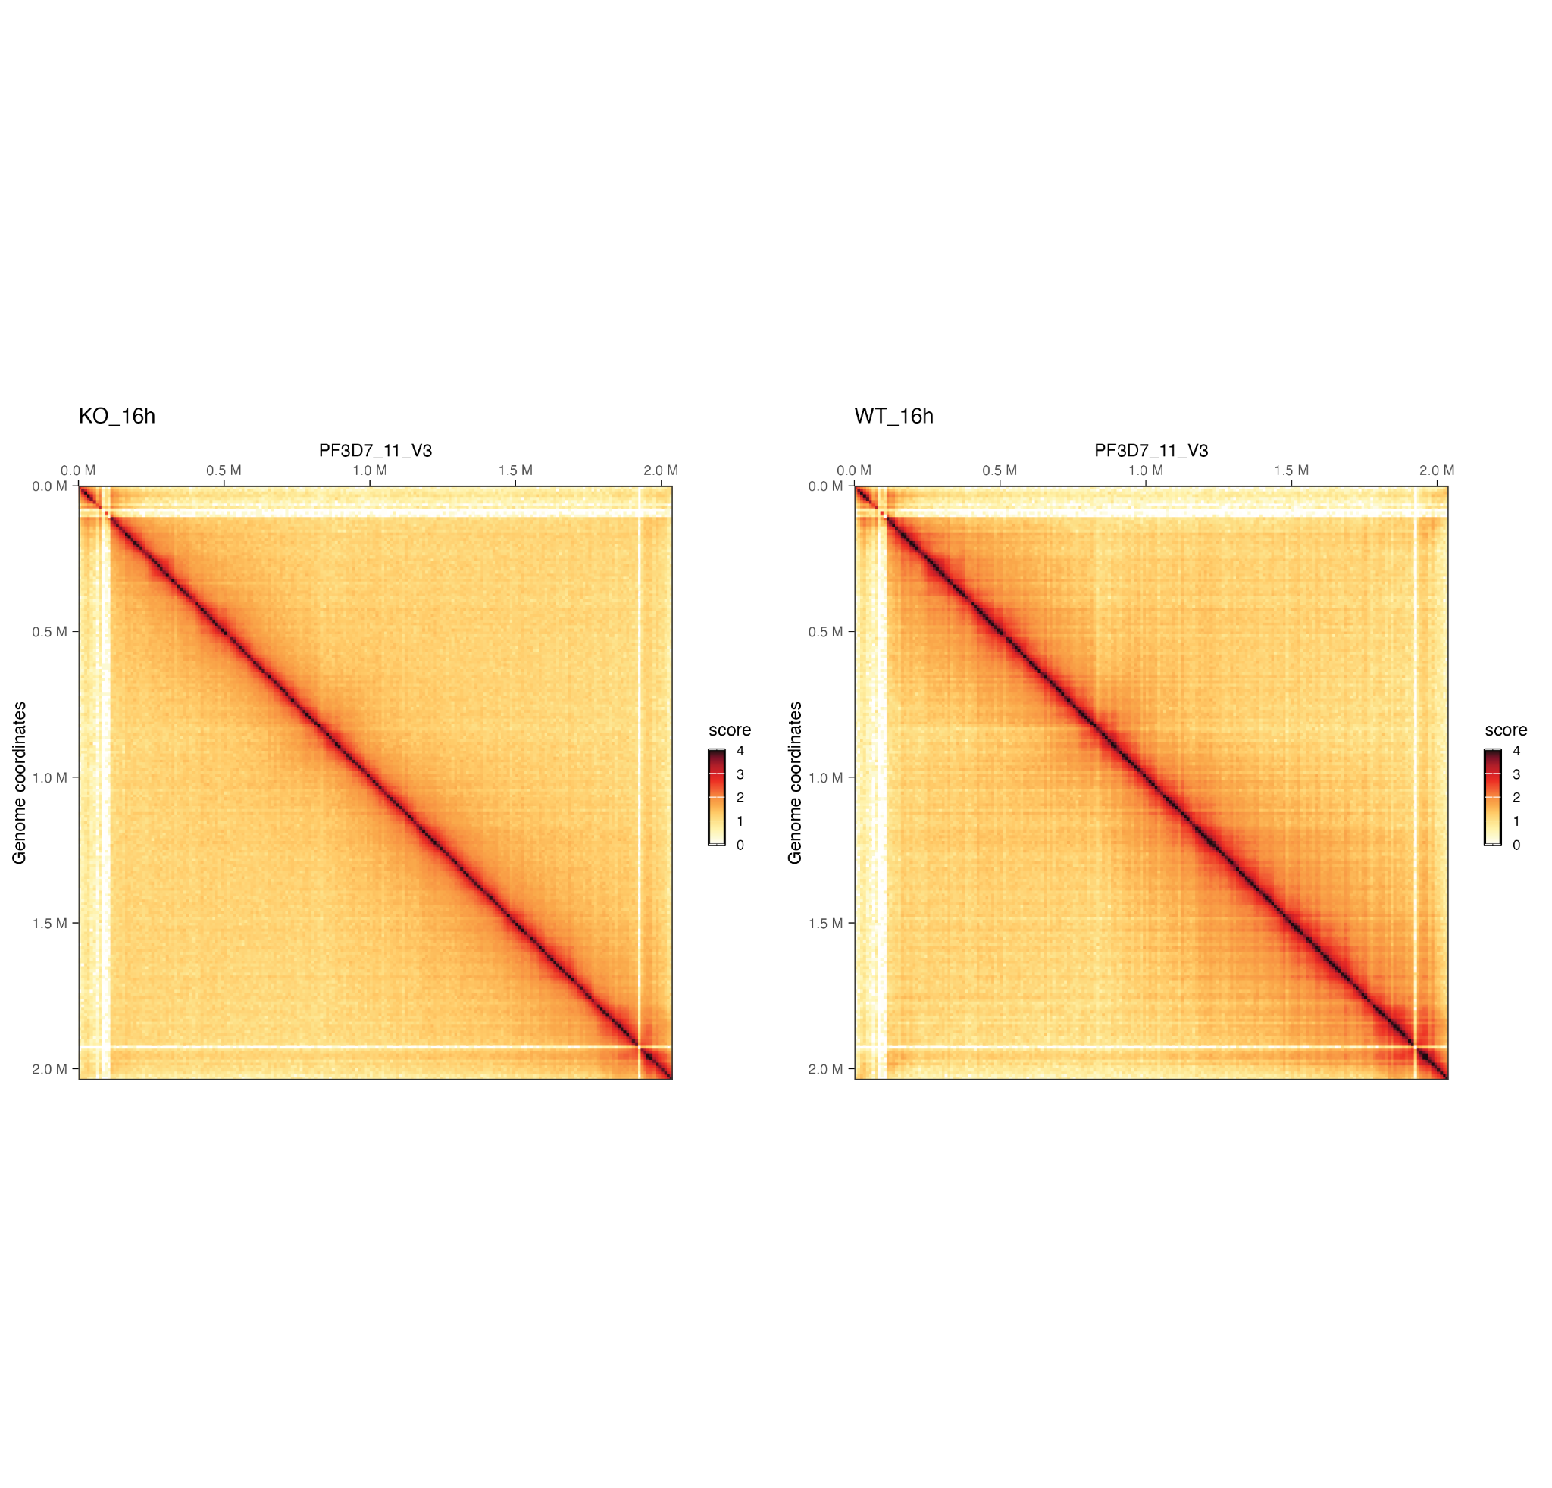
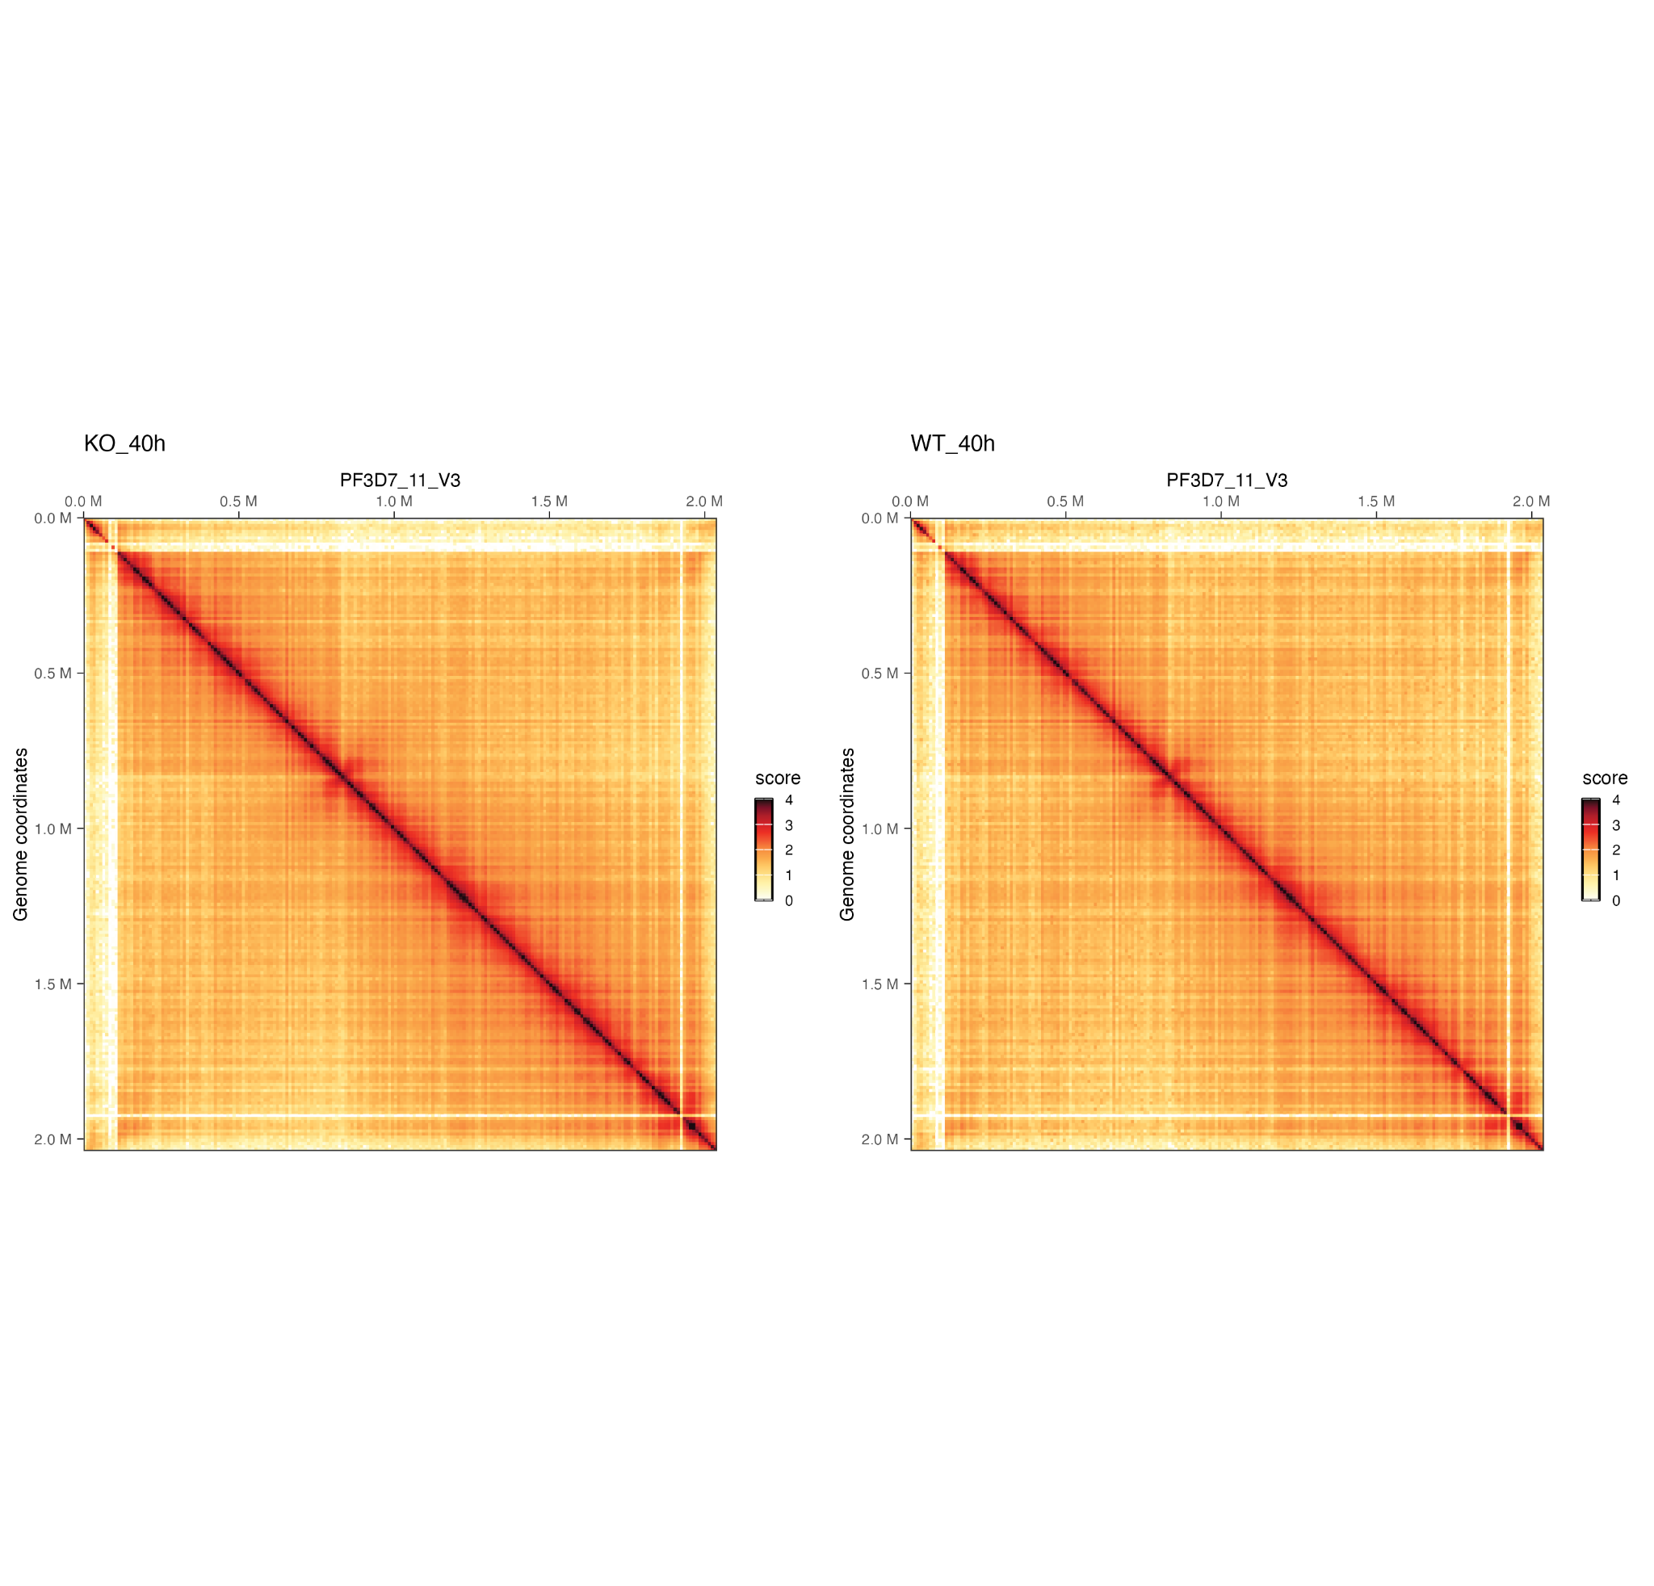
Hi-C Contact Maps
chr11
Introduction
Biological question
Pipeline
Results
Discussion
Notes:
Within the apicomplexa family, we can the genus Plasmodium. Malaria causing parasites belong to this genus.

Slide 53
Differentially Interacting Regions
Introduction
Biological question
Pipeline
Results
Discussion
Notes:
Within the apicomplexa family, we can the genus Plasmodium. Malaria causing parasites belong to this genus.

Slide 54
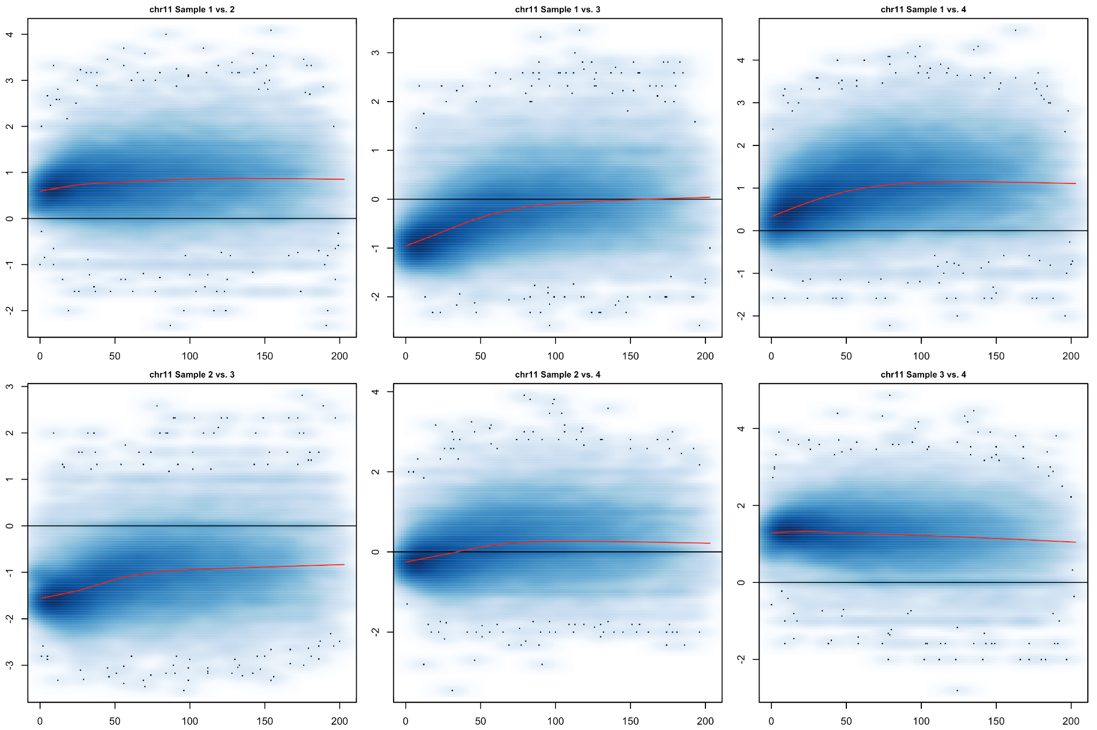
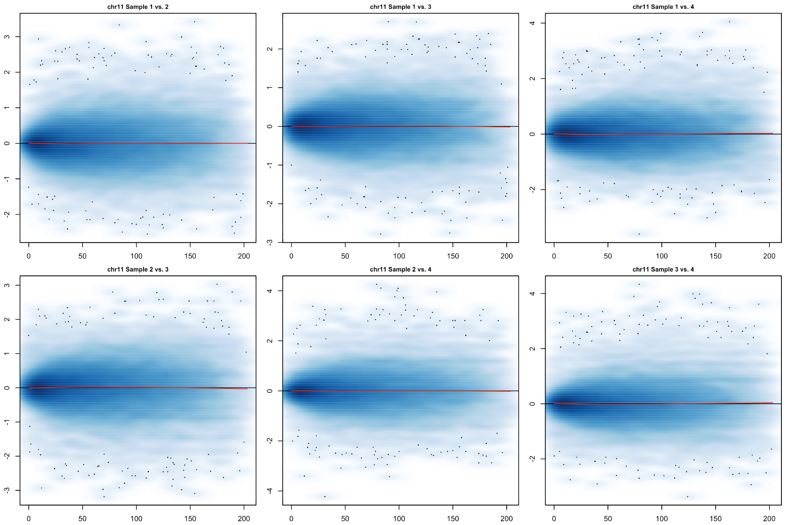
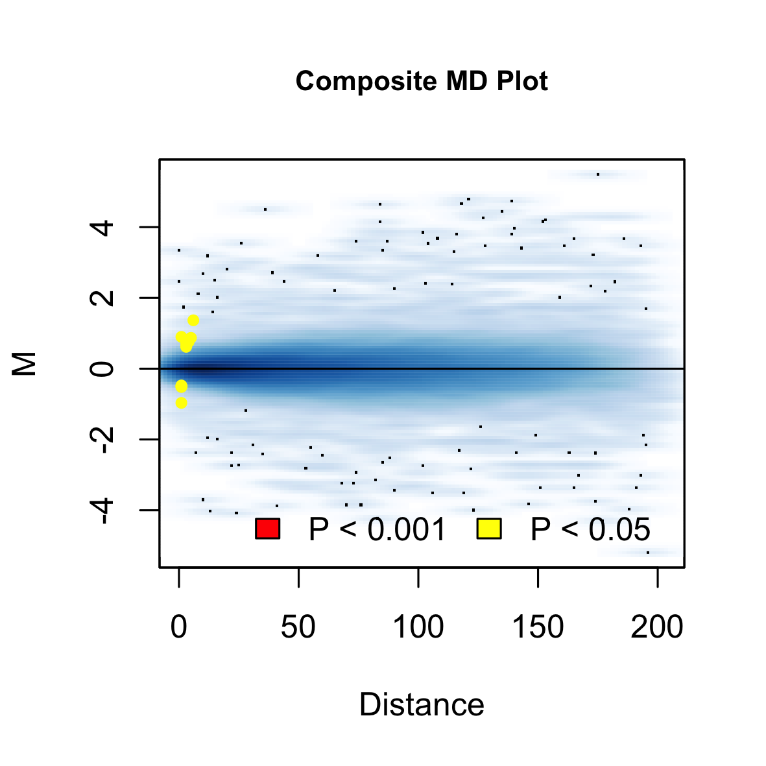
Differentially Interacting Regions
Joint normalization
DIRs
Introduction
Biological question
Pipeline
Results
Discussion
Notes:
Within the apicomplexa family, we can the genus Plasmodium. Malaria causing parasites belong to this genus.

Slide 55
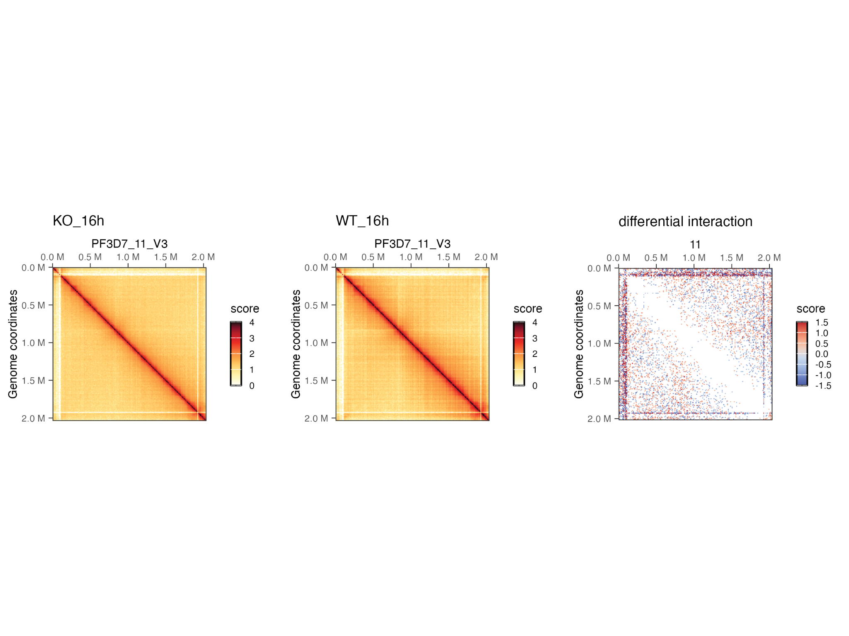
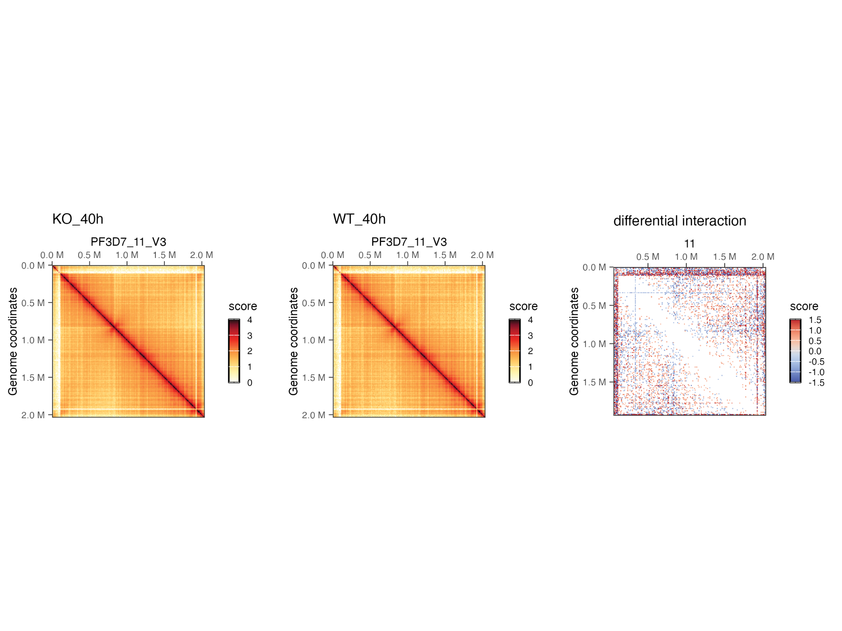
Differentially Interacting Regions
chr11
Introduction
Biological question
Pipeline
Results
Discussion
Notes:
Within the apicomplexa family, we can the genus Plasmodium. Malaria causing parasites belong to this genus.

Slide 56
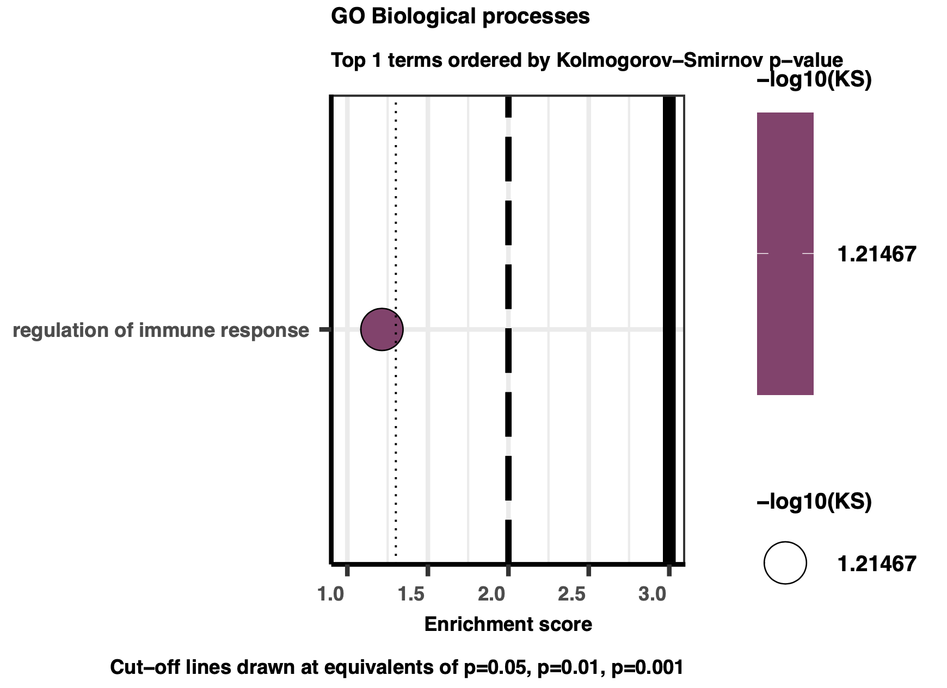
Differentially Interacting Regions - Functional Enrichment
190 DIRs overlapping with 78 genes
PfEMP1: var gene
MSP2: merozoite surface protein 2
RIFIN: proteins that help inactivate B and NK cells
RESA: ring-infected erythrocyte surface antigen helps withstand mechanical and thermal stress
14 DIRs are overlapping with 14 var genes
4 DIRs overlapping with 3 genes
beta-ketoacyl-ACP synthase III
SURFIN 1.3: part of a novel variable surface antigens family
RIFIN: proteins that help inactivate B and NK cells
No DIR overlaps with any var gene
Introduction
Biological question
Pipeline
Results
Discussion

Slide 57
Significant Interactions - Loops
Introduction
Biological question
Pipeline
Results
Discussion
Notes:
Within the apicomplexa family, we can the genus Plasmodium. Malaria causing parasites belong to this genus.

Slide 58
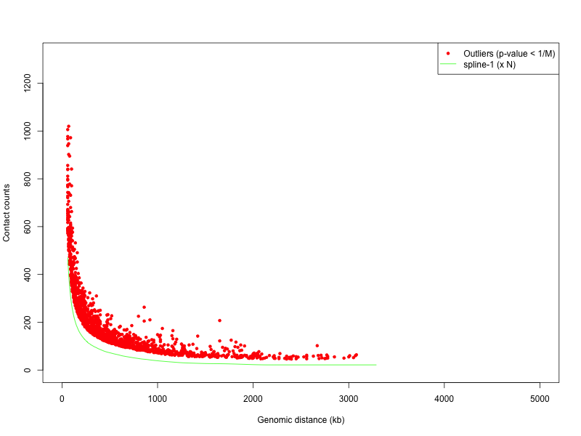
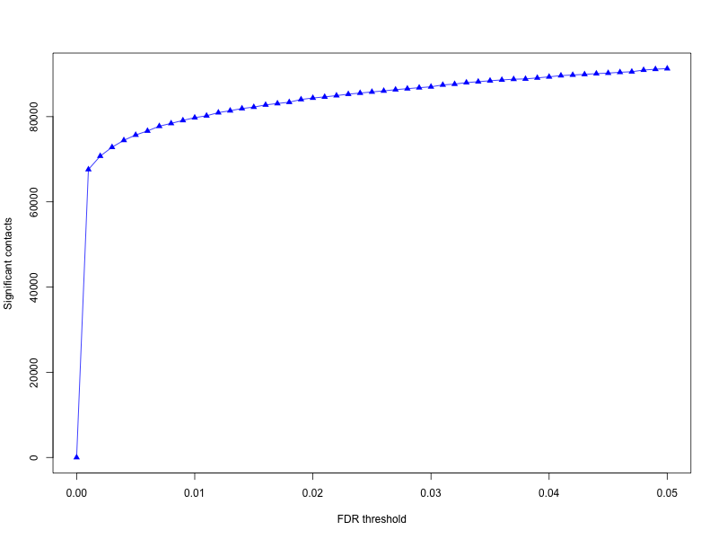
Significant Interactions - Loops
Example stats
Introduction
Biological question
Pipeline
Results
Discussion
Notes:
Within the apicomplexa family, we can the genus Plasmodium. Malaria causing parasites belong to this genus.

Slide 59
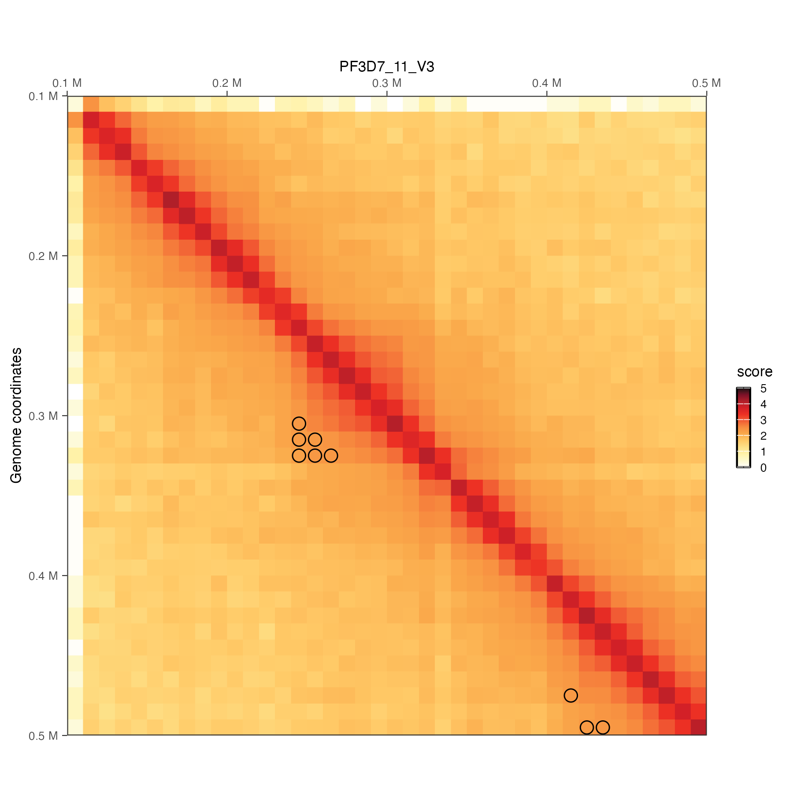
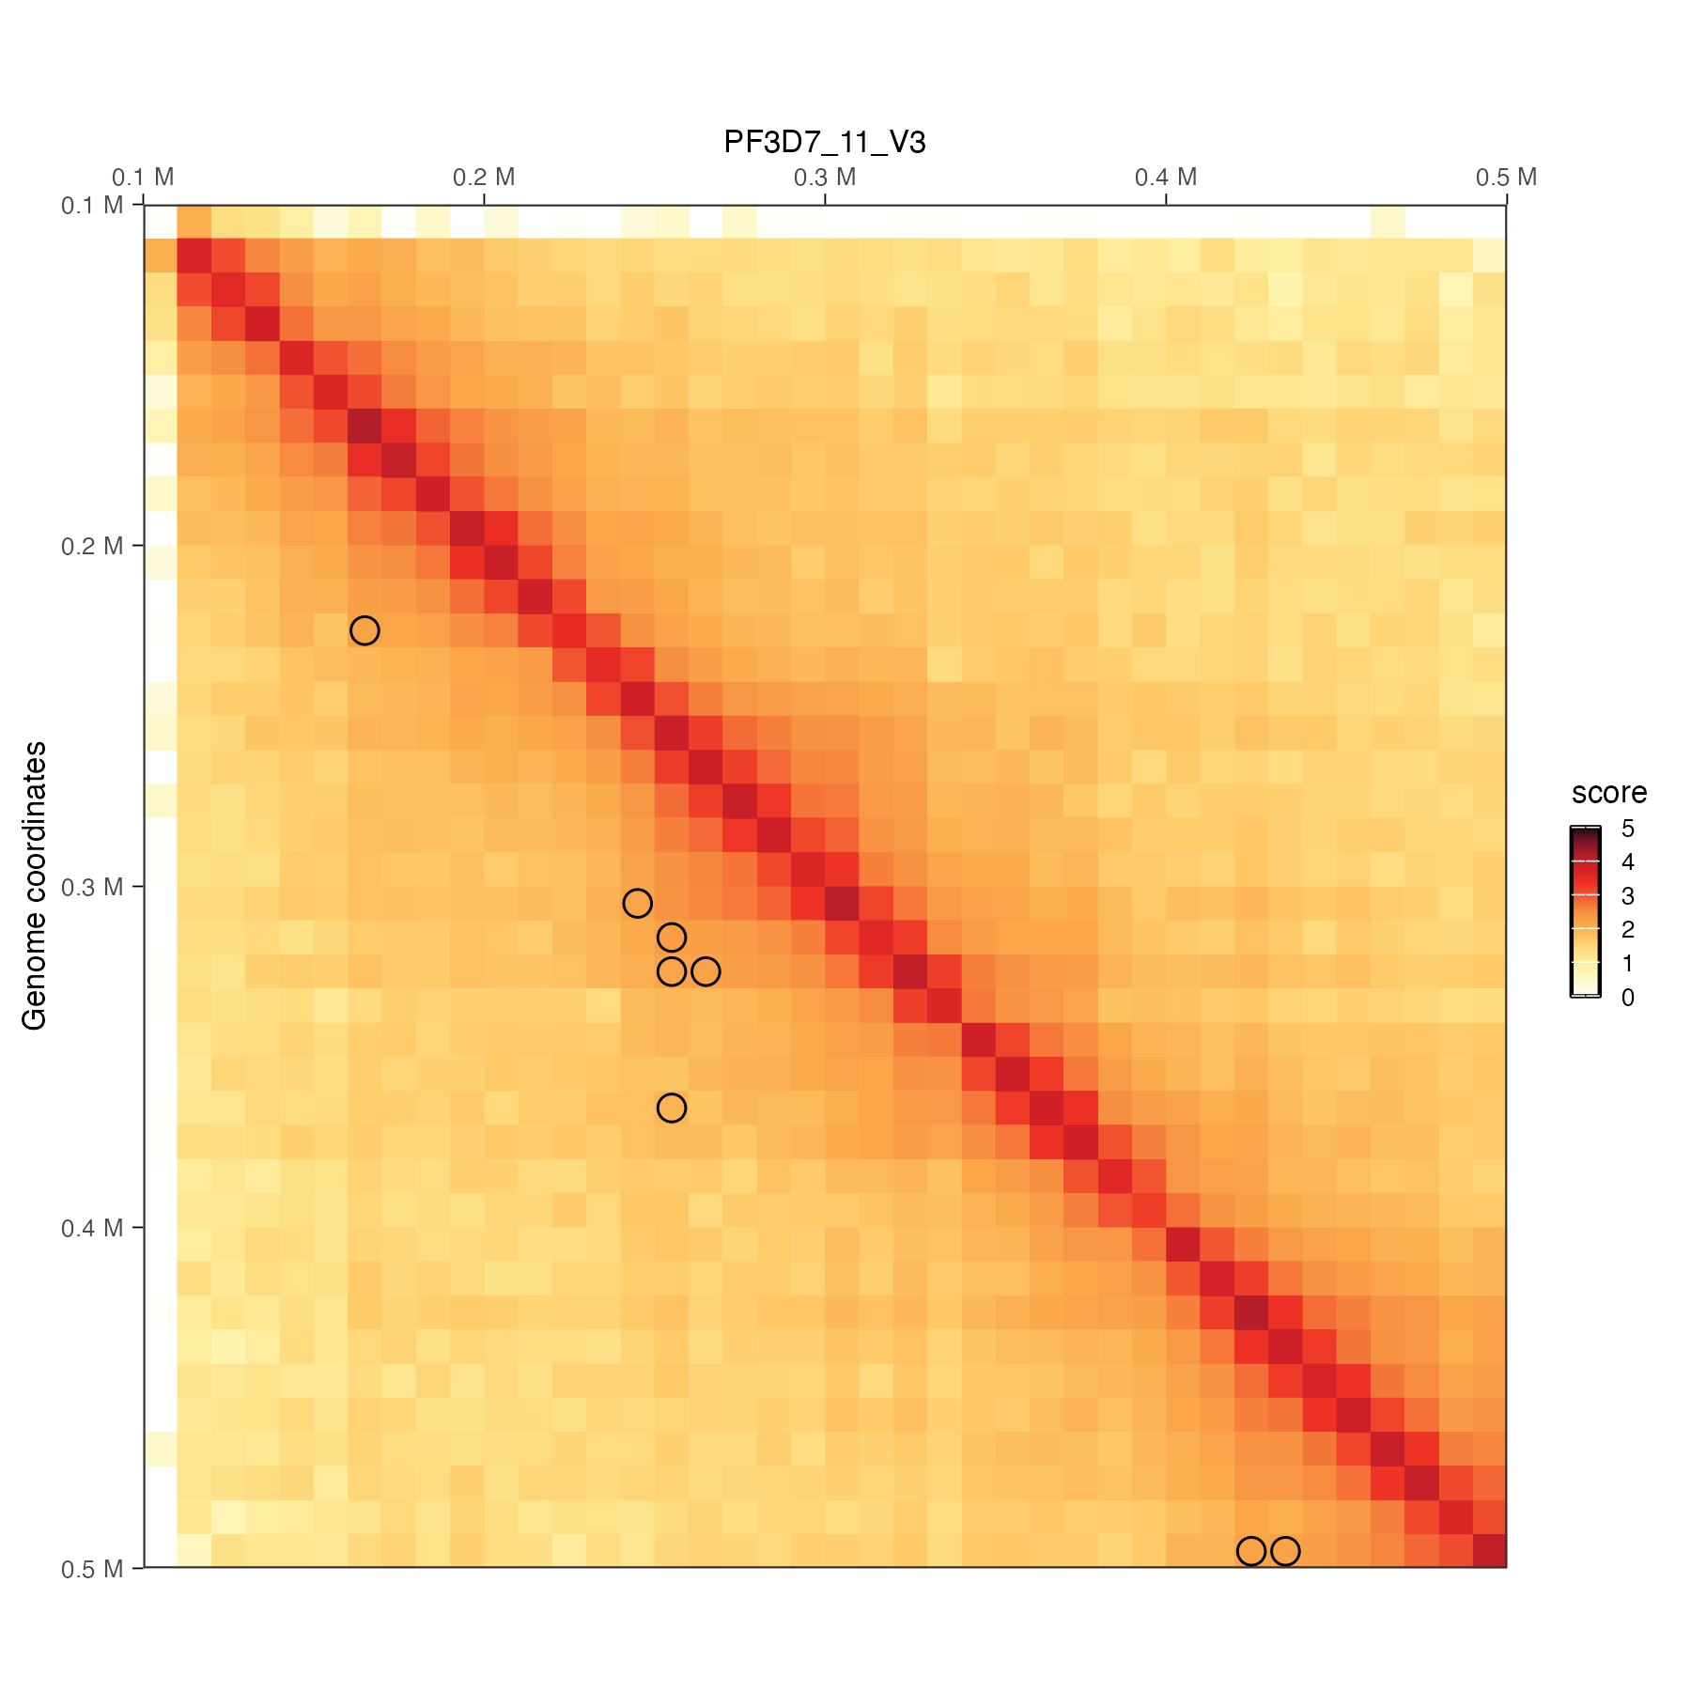
Significant Interactions - Loops
chr11
rep1
rep1
rep2
Subset overlapping interactions between replicates.
Introduction
Biological question
Pipeline
Results
Discussion
Notes:
Within the apicomplexa family, we can the genus Plasmodium. Malaria causing parasites belong to this genus.

Slide 60
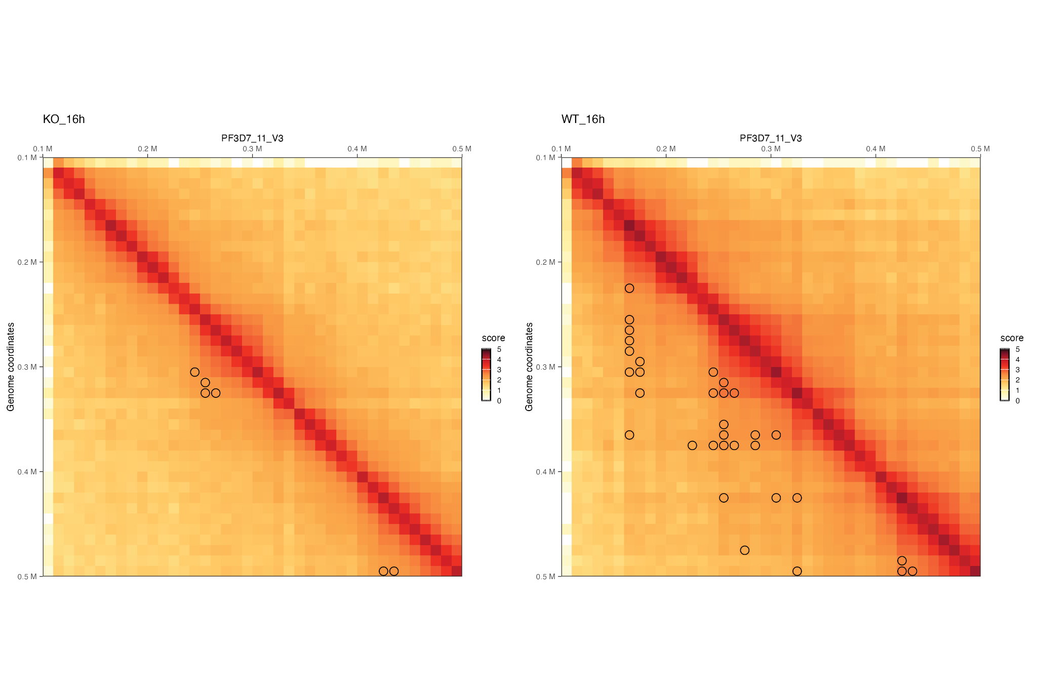
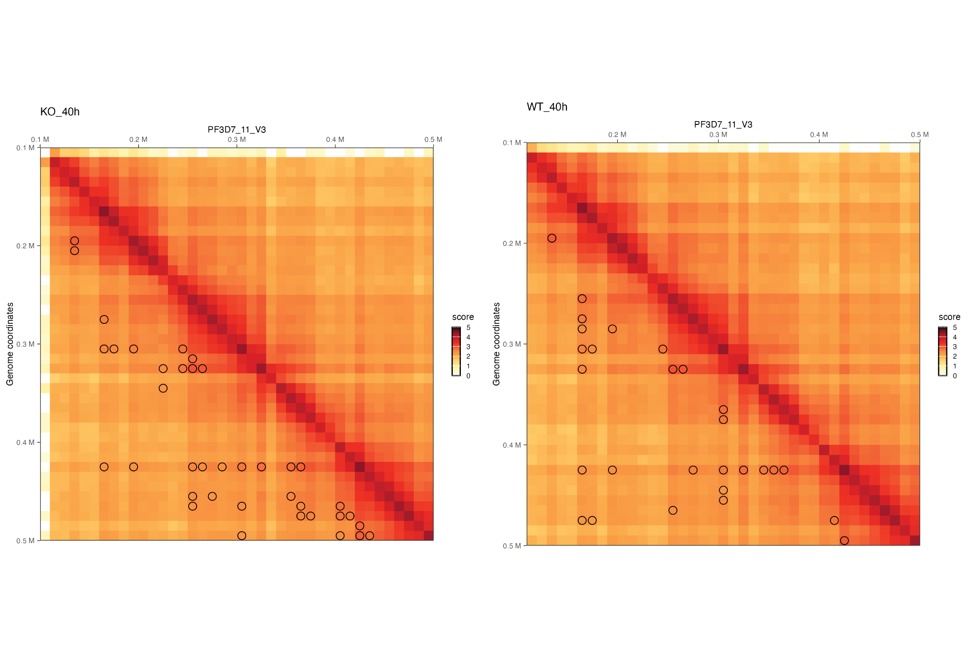
Significant Interactions - Loops
chr11
ApiAP2 gene locus:
chr11:328877 - 336810
Introduction
Biological question
Pipeline
Results
Discussion
Notes:
Within the apicomplexa family, we can the genus Plasmodium. Malaria causing parasites belong to this genus.

Slide 61
Significant Interactions - Loops
chr11
ApiAP2 gene locus:
chr11:328877 - 336810
Introduction
Biological question
Pipeline
Results
Discussion
Notes:
Within the apicomplexa family, we can the genus Plasmodium. Malaria causing parasites belong to this genus.

Slide 62
Significant Interactions - Functional Characterization
Aggregate replicates
Significant interactions
FILTERS
Annotation
ORA
0.90 quantile of contact score
FDR < 0.001
Introduction
Biological question
Pipeline
Results
Discussion
Notes:
Within the apicomplexa family, we can the genus Plasmodium. Malaria causing parasites belong to this genus.

Slide 63
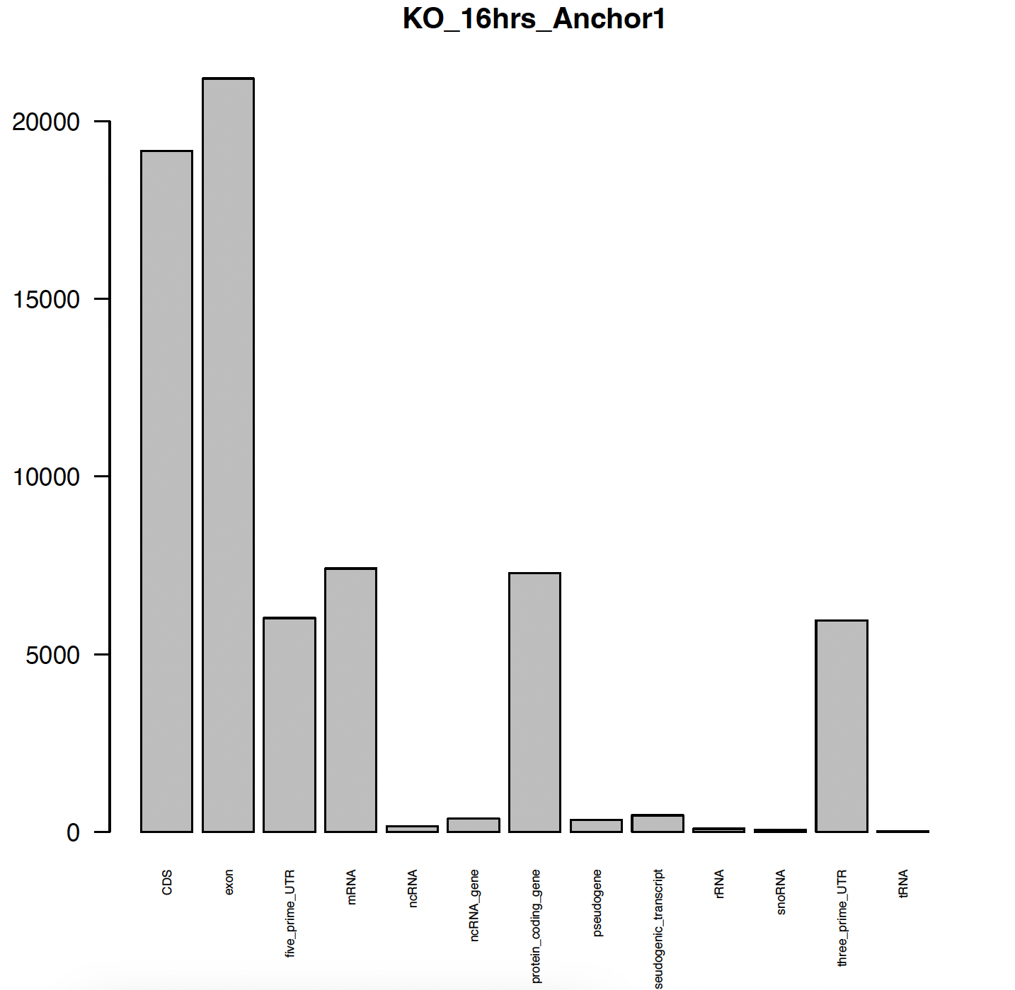
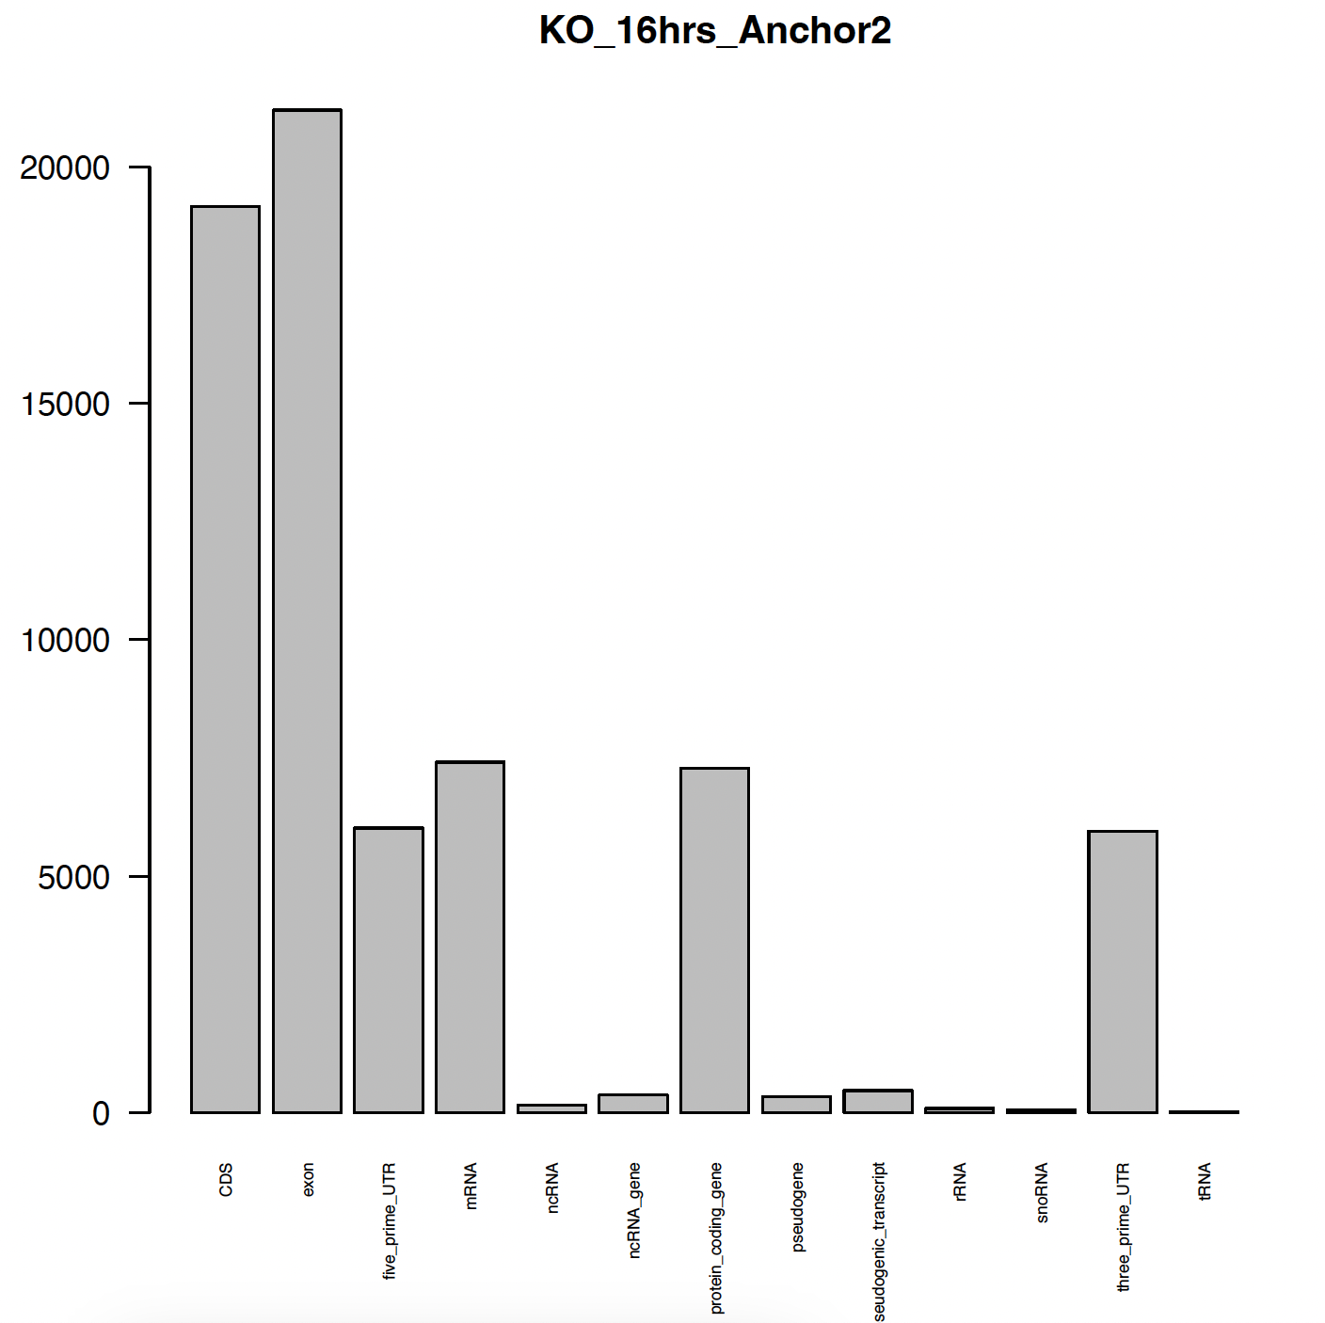
Significant Interactions - Functional Characterization
Annotation
3D space interaction
Introduction
Biological question
Pipeline
Results
Discussion
Notes:
Within the apicomplexa family, we can the genus Plasmodium. Malaria causing parasites belong to this genus.

Slide 64
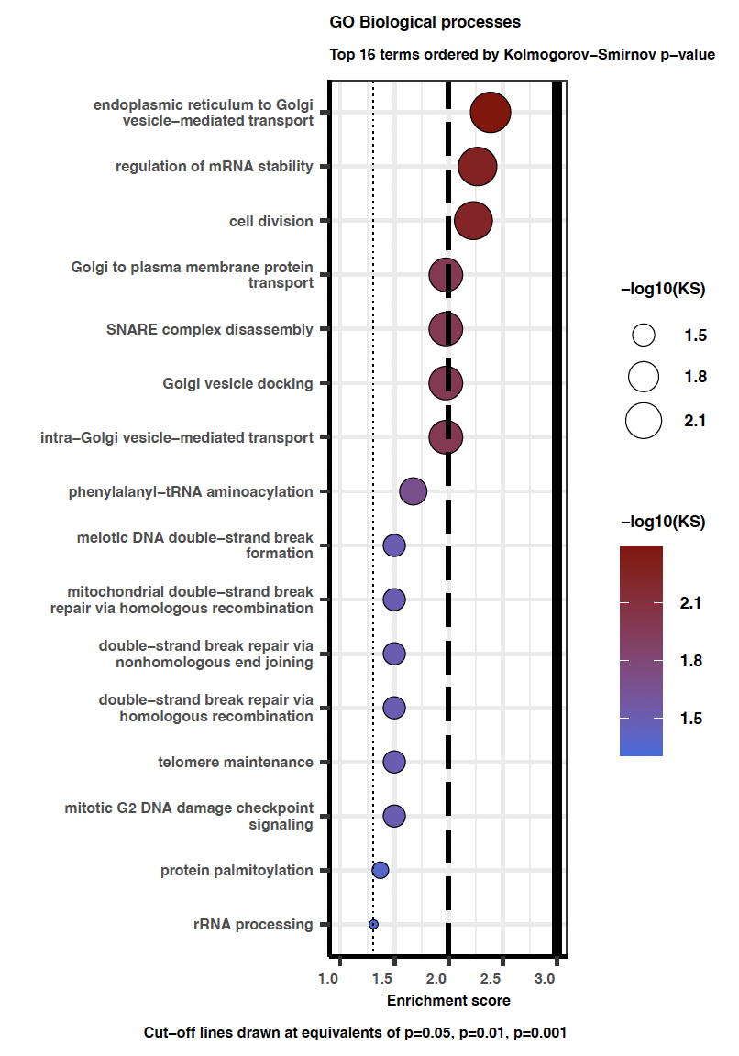

Significant Interactions - Functional Characterization
Introduction
Biological question
Pipeline
Results
Discussion

Slide 65


Significant Interactions - Functional Characterization
Introduction
Biological question
Pipeline
Results
Discussion
Notes:
Within the apicomplexa family, we can the genus Plasmodium. Malaria causing parasites belong to this genus.

Slide 66
Outline
1. Introduction to 3D genome organization and Hi-C
2. Malaria: P. falciparum life cycle and genome
3. Research question
4. Pipeline
5. Results
6. Conclusion and limitations
Introduction
Biological question
Pipeline
Results
Discussion
Notes:
The apical complex allows this versatile lifestyle.

Slide 67

Discussion
High correlation of biological replicates.
Comparative analysis revealed a significant reduction in long-distance interactions between WT and Δpfap2-p.
Our results confirmed the hypothesis: chromatin compaction is impaired in PfAP2-P-deficient parasites.
Introduction
Biological question
Pipeline
Results
Discussion
Notes:
Stratum-adjusted Correlation Coefficient (SCC) indicated clear correlation within biological replicates except for 40hpi samples. This is can biologically relevant since not a significant chromatin architectural change was expected at Trophozoite stage.
Comparative analysis of the WT and Δpfap2-p lines revealed a slight reduction in long-distance interactions and heterochromatin clusters compared with background
Chromatin compaction is impaired in PfAP2-P-deficient parasites, increasing chromatin accessibility and increased expression of var and genes involved in sexual differentiation

Slide 68

Limitations
HiCFlow is semi-automated. Very long runtime.
Plasmodium has a relatively simple chromatin structure - lack of well defined TADs and compartments.
In the future we can include integration with other omics to refine the analysis.
Better way to handle Biological Replicates
Introduction
Biological question
Pipeline
Results
Discussion
Notes:
HiCFlow is semi automated. Installation part needs to be automated and TAD/loop analysis will be added and automated in future. Runtime is huge (took 11 days to run 8 samples).
Plasmodium doesn't have a complex chromatin structure - well defined TADs/compartments does not exists. It is therefore challenging to interpret the data without deep domain knowledge.
Include integration of other sequencing technologies such as Chipseq if available for refined compartment analysis in future.

